Slide 1
Chapter 29 | Reducing Risks Through Emissions Mitigation

Slide 2
Ch. 29 | Reducing Risks Through Emissions Mitigation
29
Key Message #1
Mitigation-Related Activities Within the United States
Mitigation-related activities are taking place across the United States at the federal, state, and local levels as well as in the private sector. Since the Third National Climate Assessment, a growing number of states, cities, and businesses have pursued or deepened initiatives aimed at reducing emissions.

Slide 3
Ch. 29 | Reducing Risks Through Emissions Mitigation
29
Key Message #2
The Risks of Inaction
In the absence of more significant global mitigation efforts, climate change is projected to impose substantial damages on the U.S. economy, human health, and the environment. Under scenarios with high emissions and limited or no adaptation, annual losses in some sectors are estimated to grow to hundreds of billions of dollars by the end of the century. It is very likely that some physical and ecological impacts will be irreversible for thousands of years, while others will be permanent.

Slide 4
Ch. 29 | Reducing Risks Through Emissions Mitigation
29
Key Message #3
Avoided or Reduced Impacts Due to Mitigation
Many climate change impacts and associated economic damages in the United States can be substantially reduced over the course of the 21st century through global-scale reductions in greenhouse gas emissions, though the magnitude and timing of avoided risks vary by sector and region. The effect of near-term emissions mitigation on reducing risks is expected to become apparent by mid-century and grow substantially thereafter.

Slide 5
Ch. 29 | Reducing Risks Through Emissions Mitigation
29
Key Message #4
Interactions Between Mitigation and Adaptation
Interactions between mitigation and adaptation are complex and can lead to benefits, but they also have the potential for adverse consequences. Adaptation can complement mitigation to substantially reduce exposure and vulnerability to climate change in some sectors. This complementarity is especially important given that a certain degree of climate change due to past and present emissions is unavoidable.

Slide 6
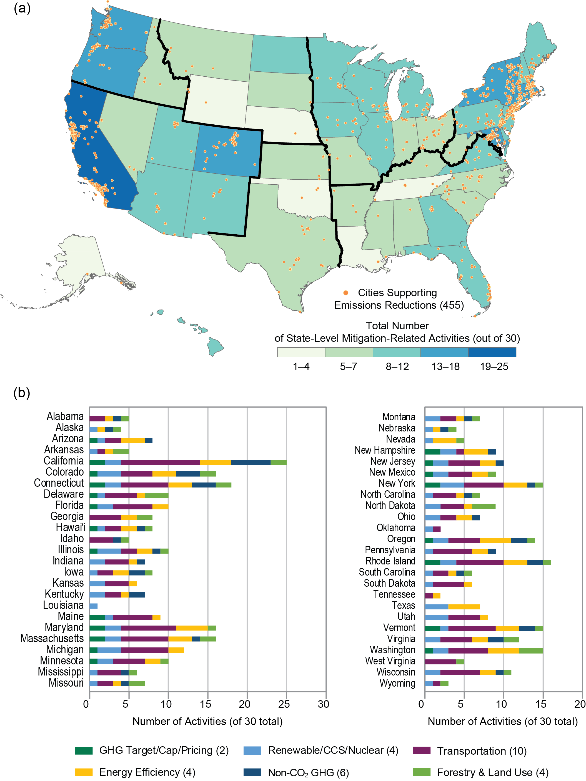
Fig. 29.1: Mitigation-Related Activities at State and Local Levels
Ch. 29 | Reducing Risks Through Emissions Mitigation
The map (a) shows the number of mitigation-related activities at the state level (out of 30 illustrative activities) as well as cities supporting emissions reductions; the chart (b) depicts the type and number of activities by state.³⁶ Several territories also have a variety of mitigation-related activities including American Sāmoa, the Federated States of Micronesia, Guam, Northern Mariana Islands, Puerto Rico, and the U.S. Virgin Islands.^{42,45} Sources: (a) EPA and ERT, Inc.; (b) adapted from America’s Pledge 2017.³⁶
Notes:
36. America’s Pledge, 2017: America’s Pledge Phase 1 Report: States, Cities, and Businesses in the United States Are Stepping Up on Climate Action. Bloomberg Philanthropies, New York, NY, 123 pp. https://www.bbhub.io/dotorg/sites/28/2017/11/AmericasPledgePhaseOneReportWeb.pdf
42. DSIRE, 2017: Database of State Incentives for Renewables & Efficiency (DSIRE) [online tool]. NC State University, NC Clean Energy Technology Center, Raleigh, NC. http://www.dsireusa.org/
45. Barbose, G.L., 2016: U.S. Renewables Portfolio Standards 2016 Annual Status Report. LBNL-1005057. Lawrence Berkeley National Laboratory, Berkeley, CA. https://emp.lbl.gov/projects/renewables-portfolio/

Slide 7
Table 29.1: Multisector Modeling Frameworks since NCA3
Ch. 29 | Reducing Risks Through Emissions Mitigation
Collaboration or Project Name | Host/Lead Organization and References | Sectors Covered | Coverage
Benefits of Reduced Anthropogenic Climate changE (BRACE) | National Center for Atmospheric Research (O’Neill et al. 2017)⁴ | Heat extremes and health, agriculture and land use, tropical cyclones, sea level rise, drought and conflict | Global
Costs of Inaction and Resource scarcity: Consequences for Long-term Economic growth (CIRCLE) | Organisation for Economic Co-operation and Development (OECD 2015)⁵⁵ | Tourism, agriculture, coastal, energy, extreme precipitation events, health | Global
Inter-Sectoral Impact Model Intercomparison Project (ISIMIP) | Potsdam Institute for Climate Impact Research (Huber et al. 2014)⁵⁶ | Water, agriculture, biomes, infrastructure, health/malaria, fishery, permafrost | Global
American Climate Prospectus (ACP) | Climate Impact Lab (Houser et al. 2015; Hsiang et al. 2017)^{3,5} | Agriculture, health, labor productivity, crime and conflict, coastal, energy | United States
Selection of Multisector Impacts Modeling Frameworks since NCA3. Source: adapted from Diaz and Moore 2017.⁵⁴
Notes:
3: Hsiang, S., R. Kopp, A. Jina, J. Rising, M. Delgado, S. Mohan, D.J. Rasmussen, R. Muir-Wood, P. Wilson, M. Oppenheimer, K. Larsen, and T. Houser, 2017: Estimating economic damage from climate change in the United States. Science, 356 (6345), 1362-1369. http://dx.doi.org/10.1126/science.aal4369
4: O’Neill, B.C., J. M. Done, A. Gettelman, P. Lawrence, F. Lehner, J.-F. Lamarque, L. Lin, A. J. Monaghan, K. Oleson, X. Ren, B. M. Sanderson, C. Tebaldi, M. Weitzel, Y. Xu, B. Anderson, M.J. Fix, and S. Levis, 2017: The Benefits of Reduced Anthropogenic Climate changE (BRACE): A synthesis. Climatic Change. http://dx.doi.org/10.1007/s10584-017-2009-x
5: Houser, T., S. Hsiang, R. Kopp, and K. Larsen, 2015: Economic Risks of Climate Change: An American Prospectus. Columbia University Press, New York, 384 pp.
54: Diaz, D. and F. Moore, 2017: Valuing Potential Climate Impacts: A Review of Current Limitations and the Research Frontier. Report #3002011885. EPRI, Palo Alto, CA, 34 pp. https://www.epri.com/#/pages/product/3002011885/
55: OECD, 2015: The Economic Consequences of Climate Change. OECD (Organisation for Economic Co-operation and Development) Publishing, Paris, 140 pp. http://dx.doi.org/10.1787/9789264235410-en
56: Huber, V., H.J. Schellnhuber, N.W. Arnell, K. Frieler, A.D. Friend, D. Gerten, I. Haddeland, P. Kabat, H. Lotze-Campen, W. Lucht, M. Parry, F. Piontek, C. Rosenzweig, J. Schewe, and L. Warszawski, 2014: Climate impact research: Beyond patchwork. Earth System Dynamics, 5 (2), 399-408. http://dx.doi.org/10.5194/esd-5-399-2014

Slide 8
Table 29.1 (cont.): Multisector Modeling Frameworks since NCA3
Ch. 29 | Reducing Risks Through Emissions Mitigation
Collaboration or Project Name | Host/Lead Organization and References | Sectors Covered | Coverage
Climate Change Impacts and Risk Analysis (CIRA) | U.S. Environmental Protection Agency (EPA 2015, 2017)^{2,57} | More than 20 specific impacts categorized into 6 broad sectors: health (including labor productivity), infrastructure, electricity, water resources, agriculture, ecosystems | United States
California Climate Change Assessments | State of California (Cayan et al. 2008, 2013; California Energy Commission 2006)^{58,59,60} | Public health, agriculture, energy, coastal, water resources, ecosystems, wildfire, recreation | State-Level
Colorado Climate Change Vulnerability Study | Colorado Energy Office (Gordon and Ojima 2015)⁶¹ | Ecosystems, water, agriculture, energy, transportation, recreation and tourism, public health | State-Level
New York ClimAID Project | New York State Energy Research and Development Authority (Rosenzweig et al. 2011; Horton et al. 2014)^{62,63} | Water resources, coastal zones, ecosystems, agriculture, energy, transportation, telecommunications, public health | State-Level
Selection of Multisector Impacts Modeling Frameworks since NCA3. Source: adapted from Diaz and Moore 2017.⁵⁴
Notes:
2: EPA, 2017: Multi-model Framework for Quantitative Sectoral Impacts Analysis: A Technical Report for the Fourth National Climate Assessment. EPA 430‐R‐17‐001. U.S. Environmental Protection Agency (EPA), Washington, DC, 271 pp. https://cfpub.epa.gov/si/si_public_record_Report.cfm?dirEntryId=335095
54: Diaz, D. and F. Moore, 2017: Valuing Potential Climate Impacts: A Review of Current Limitations and the Research Frontier. Report #3002011885. EPRI, Palo Alto, CA, 34 pp. https://www.epri.com/#/pages/product/3002011885/
57: EPA, 2015: Climate Change in the United States: Benefits of Global Action. EPA 430-R-15-001. U.S. Environmental Protection Agency (EPA), Office of Atmospheric Programs, Washington, DC, 93 pp. https://www.epa.gov/cira/downloads-cira-report
58: Cayan, D., A. Luers, G. Franco, M. Hanemann, B. Croes, and E. Vine, 2008: California at a crossroads: Climate change science informing policy. Climatic Change, 87 (1 Suppl.), 1-322. https://link.springer.com/journal/10584/87/1/suppl/page/1
59: Cayan, D.R., S. Moser, G. Franco, M. Hanemann, and M.-A. Jones, Eds., 2013: California Climate Scenarios Assessment. Springer Atmospheric Sciences. Springer, The Netherlands, 554 pp.
60: Cayan, D., A.L. Luers, M. Hanemann, G. Franco, and B. Croes, 2006: Scenarios of Climate Change in California: An Overview. CEC-500-2005-186-SF. California Energy Commission, Sacramento, CA, 47 pp. http://www.energy.ca.gov/2005publications/CEC-500-2005-186/CEC-500-2005-186-SF.PDF
61: Childress, A., E. Gordon, T. Jedd, R. Klein, J. Lukas, and R. McKeown, 2015: Colorado Climate Change Vulnerability Study. Gordon, E. and D. Ojima, Eds. University of Colorado Boulder, Boulder, CO, 176 pp. http://wwa.colorado.edu/climate/co2015vulnerability/
62: Rosenzweig, C., W. Solecki, A. DeGaetano, M. O’Grady, S. Hassol, and P. Grabhorn, Eds., 2011: Responding to Climate Change in New York State: The ClimAID Integrated Assessment for Effective Climate Change Adaptation. Technical report. NYSERDA Report 11-18. New York State Energy Research and Development Authority (NYSERDA), Albany, NY, 149 pp. https://www.nyserda.ny.gov/climaid
63: Horton, R.H., D.A. Bader, C. Rosenzweig, A.T. DeGaetano, and W. Solecki, 2014: Climate Change in New York State. Updating the 2011 ClimAID Climate Risk Information, Supplement to NYSERDA Report 11-18. NYSERDA Report 14-26. New York State Energy Research and Development Authority (NYSERDA), Albany, NY, 17 pp. https://www.nyserda.ny.gov/-/media/Files/Publications/Research/Environmental/ClimAID/2014-ClimAid-Report.pdf

Slide 9
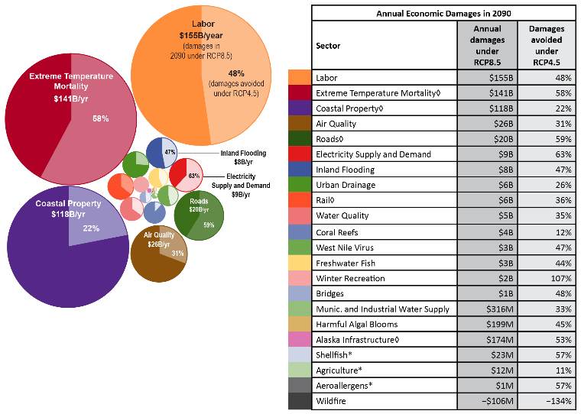
Fig. 29.2: Projected Damages and Potential for Risk Reduction by Sector
Ch. 29 | Reducing Risks Through Emissions Mitigation
The total area of each circle represents the projected annual economic damages (in 2015 dollars) under a higher scenario (RCP8.5) in 2090 relative to a no-change scenario. The decrease in damages under a lower scenario (RCP4.5) compared to RCP8.5 is shown in the lighter-shaded area of each circle. Where applicable, sectoral results assume population change over time, which in the case of winter recreation leads to positive effects under RCP4.5, as increased visitors outweigh climate losses. Importantly, many sectoral damages from climate change are not included here, and many of the reported results represent only partial valuations of the total physical damages. See EPA 2017 for ranges surrounding the central estimates presented in the figure; results assume limited or no adaptation.² Adaptation was shown to reduce overall damages in sectors identified with the diamond symbol but was not directly modeled in, or relevant to, all sectors. Asterisks denote sectors with annual damages that may not be visible at the given scale. Only one impact (wildfire) shows very small positive effects, owing to projected landscape-scale shifts to vegetation with longer fire return intervals (see Ch. 6: Forests for a discussion on the weight of evidence regarding projections of future wildfire activity). The online version of this figure includes value ranges for numbers in the table. Due to space constraints, the ranges are not included here. Source: adapted from EPA 2017.²
Notes:
2: EPA, 2017: Multi-model Framework for Quantitative Sectoral Impacts Analysis: A Technical Report for the Fourth National Climate Assessment. EPA 430‐R‐17‐001. U.S. Environmental Protection Agency (EPA), Washington, DC, 271 pp. https://cfpub.epa.gov/si/si_public_record_Report.cfm?dirEntryId=335095

Slide 10
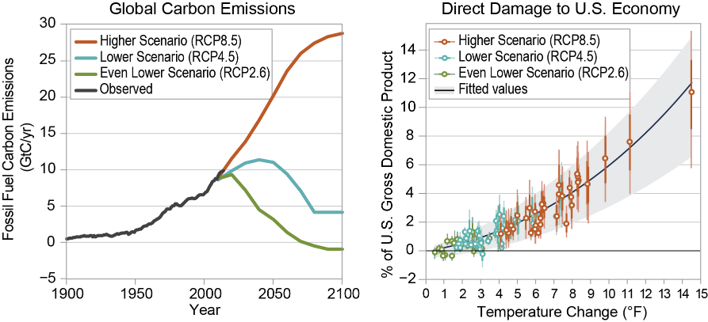
Fig. 29.3: Estimates of Direct Economic Damage from Temperature Change
Ch. 29 | Reducing Risks Through Emissions Mitigation
The left graph shows the observed and projected changes in fossil fuel and industrial emissions of CO₂ from human activities (emissions from land-use change do not appear in the figure; within the RCPs these emissions are less than 1 GtC per year by 2020 and fall thereafter). The right graph shows projections of direct damage to the current U.S. economy for six impact sectors (agriculture, crime, coasts, energy, heat mortality, and labor) as a function of global average temperature change (represented as average for 2080–2099 compared to 1980–2010). Compared to RCP8.5, lower temperatures due to mitigation under either of the lower scenarios (RCP2.6 or RCP4.5) substantially reduce median damages (dots) to the U.S. economy while also narrowing the uncertainty in potential adverse impacts. Dot-whiskers indicate the uncertainty in direct damages in 2090 (average of 2080–2099) derived from multiple combinations of climate models and forcing scenarios (dot, median; thick line, inner 66% credible interval; thin line, inner 90%). The gray shaded area represents the 90% confidence interval in the fit (black line) to the damage estimates. Damage estimates only capture adaptation to the extent that populations employed them in the historical period. Sources: (left) adapted from Wuebbles et al. 2017;⁸³ (right) adapted from Hsiang et al. 2017³ and republished with permission of American Association for the Advancement of Science.
Notes:
3: Hsiang, S., R. Kopp, A. Jina, J. Rising, M. Delgado, S. Mohan, D.J. Rasmussen, R. Muir-Wood, P. Wilson, M. Oppenheimer, K. Larsen, and T. Houser, 2017: Estimating economic damage from climate change in the United States. Science, 356 (6345), 1362-1369. http://dx.doi.org/10.1126/science.aal4369
83: Wuebbles, D.J., D.W. Fahey, K.A. Hibbard, B. DeAngelo, S. Doherty, K. Hayhoe, R. Horton, J.P. Kossin, P.C. Taylor, A.M. Waple, and C.P. Weaver, 2017: Executive summary. Climate Science Special Report: Fourth National Climate Assessment, Volume I. Wuebbles, D.J., D.W. Fahey, K.A. Hibbard, D.J. Dokken, B.C. Stewart, and T.K. Maycock, Eds. U.S. Global Change Research Program, Washington, DC, USA, 12-34. http://dx.doi.org/10.7930/J0DJ5CTG

Slide 11
Ch. 29 | Reducing Risks Through Emissions Mitigation
29
Chapter Author Team
Federal Coordinating Lead Author
Jeremy Martinich, U.S. Environmental Protection Agency
Chapter Lead
Jeremy Martinich, U.S. Environmental Protection Agency
Chapter Authors
Benjamin DeAngelo, National Oceanic and Atmospheric Administration
Delavane Diaz, Electric Power Research Institute
Brenda Ekwurzel, Union of Concerned Scientists
Guido Franco, California Energy Commission
Carla Frisch, U.S. Department of Energy
James McFarland, U.S. Environmental Protection Agency
Brian O’Neill, University of Denver (National Center for Atmospheric Research through June 2018)
Review Editor
Andrew Light, George Mason University

Slide 12
Ch. 29 | Reducing Risks Through Emissions Mitigation
29
Acknowledgments
USGCRP Coordinators
David Reidmiller, Director
Christopher W. Avery, Senior Manager

Slide 13
Martinich, J., B.J. DeAngelo, D. Diaz, B. Ekwurzel, G. Franco, C. Frisch, J. McFarland, and B. O’Neill, 2018: Reducing Risks Through Emissions Mitigation. In Impacts, Risks, and Adaptation in the United States: Fourth National Climate Assessment, Volume II [Reidmiller, D.R., C.W. Avery, D.R. Easterling, K.E. Kunkel, K.L.M. Lewis, T.K. Maycock, and B.C. Stewart (eds.)]. U.S. Global Change Research Program, Washington, DC, USA. doi: 10.7930/NCA4.2018.CH29
https://nca2018.globalchange.gov/chapter/mitigation

