Slide 1
Chapter 24 | Northwest

Slide 2
Ch. 24 | Northwest
24
Key Message #1
Natural Resource Economy
Climate change is already affecting the Northwest’s diverse natural resources, which support sustainable livelihoods; provide a robust foundation for rural, tribal, and Indigenous communities; and strengthen local economies. Climate change is expected to continue affecting the natural resource sector, but the economic consequences will depend on future market dynamics, management actions, and adaptation efforts. Proactive management can increase the resilience of many natural resources and their associated economies.

Slide 3
Ch. 24 | Northwest
24
Key Message #2
Natural World and Cultural Heritage
Climate change and extreme events are already endangering the well-being of a wide range of wildlife, fish, and plants, which are intimately tied to tribal subsistence culture and popular outdoor recreation activities. Climate change is projected to continue to have adverse impacts on the regional environment, with implications for the values, identity, heritage, cultures, and quality of life of the region’s diverse population. Adaptation and informed management, especially culturally appropriate strategies, will likely increase the resilience of the region’s natural capital.

Slide 4
Ch. 24 | Northwest
24
Key Message #3
Infrastructure
Existing water, transportation, and energy infrastructure already face challenges from flooding, landslides, drought, wildfire, and heat waves. Climate change is projected to increase the risks from many of these extreme events, potentially compromising the reliability of water supplies, hydropower, and transportation across the region. Isolated communities and those with systems that lack redundancy are the most vulnerable. Adaptation strategies that address more than one sector, or are coupled with social and environmental co-benefits, can increase resilience.

Slide 5
Ch. 24 | Northwest
24
Key Message #4
Health
Organizations and volunteers that make up the Northwest’s social safety net are already stretched thin with current demands. Healthcare and social systems will likely be further challenged with the increasing frequency of acute events, or when cascading events occur. In addition to an increased likelihood of hazards and epidemics, disruptions in local economies and food systems are projected to result in more chronic health risks. The potential health co-benefits of future climate mitigation investments could help to counterbalance these risks.

Slide 6
Ch. 24 | Northwest
24
Key Message #5
Frontline Communities
Communities on the front lines of climate change experience the first, and often the worst, effects. Frontline communities in the Northwest include tribes and Indigenous peoples, those most dependent on natural resources for their livelihoods, and the economically disadvantaged. These communities generally prioritize basic needs, such as shelter, food, and transportation; frequently lack economic and political capital; and have fewer resources to prepare for and cope with climate disruptions. The social and cultural cohesion inherent in many of these communities provides a foundation for building community capacity and increasing resilience.

Slide 7
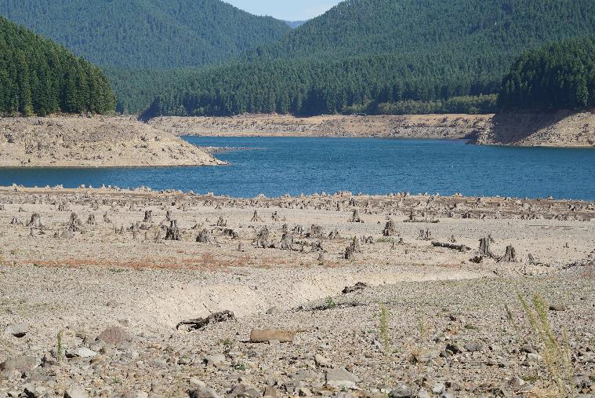
Fig. 24.1: Detroit Lake Reservoir During Multiyear Drought
Ch. 24 | Northwest
Detroit Lake Reservoir in Oregon at record-low levels in 2015. Photo credit: Dave Reinert, Oregon State University.

Slide 8
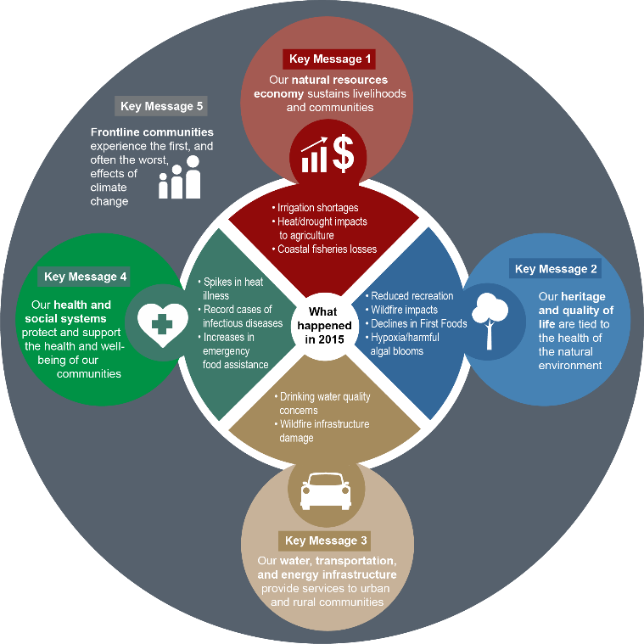
Fig. 24.2: Climate Change Will Impact Key Aspects of Life in the Northwest
Ch. 24 | Northwest
The climate-related events of 2015 provide a glimpse into the Northwest’s future, because the kinds of extreme events that affected the Northwest in 2015 are projected to become more common. The climate impacts that occurred during this record-breaking warm and dry year highlight the close interrelationships between the climate, the natural and built environment, and the health and well-being of the Northwest’s residents. Source: USGCRP.

Slide 9
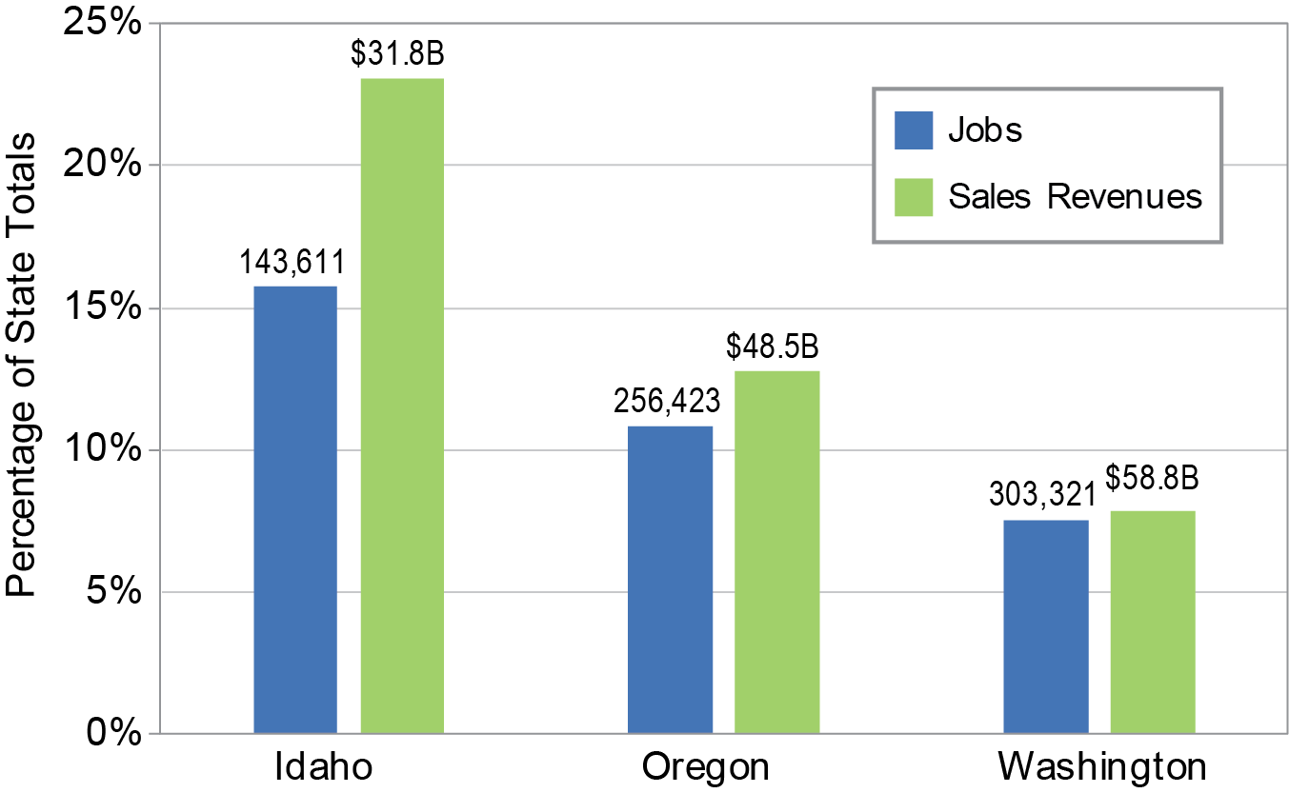
Fig. 24.3: Natural Resource Industry Jobs and Sales Revenues
Ch. 24 | Northwest
Natural resources are a key part of the Northwest economy. Climate change is putting natural resource sector jobs and sales revenues at risk. Jobs and sales figures include the agriculture, forestry, and fisheries sectors only, and are presented based on 2015 data for Idaho, Oregon, and Washington.¹⁷ Source: U.S. Forest Service and Boise State University.
Notes:
17: Sorte, B., M. Rahe, and P. Lewin, 2016: Agriculture, Food, Forestry and Fishing in the Northwest U.S: An economic overview.

Slide 10
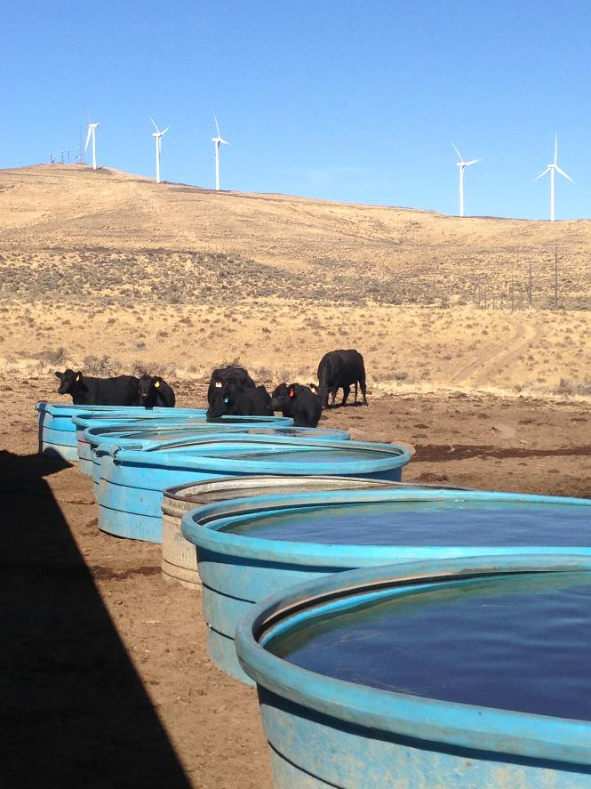
Fig. 24.4: Supplemental Watering of Livestock During Drought
Ch. 24 | Northwest
Supplemental watering of livestock in Eastern Oregon during 2015 drought. Photo credit: Sonia A. Hall.

Slide 11
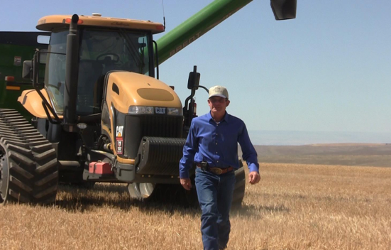
Fig. 24.5: Adaptive Agricultural Approaches in Practice
Ch. 24 | Northwest
A farmer in Oregon surveys his no-till field, a practice used to build climate resilience. Photo credit: Sylvia Kantor, Washington State University Extension.

Slide 12
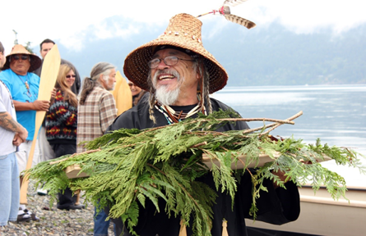
Fig. 24.6: First Salmon Ceremony of the Lummi Tribe, Washington
Ch. 24 | Northwest
First Salmon ceremony of the Lummi Tribe, Washington. Tribes in the Northwest typically honor the first salmon caught in the season through Tribal ceremonies. Photo credit: Northwest Indian Fisheries Commission (CC BY 3.0).

Slide 13
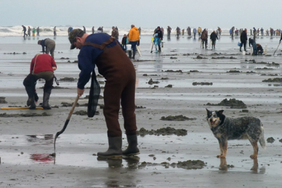
Fig. 24.7: Razor Clamming in Washington State
Ch. 24 | Northwest
Razor clamming draws crowds on the coast of Washington State. This popular recreation activity is expected to decline due to ocean acidification, harmful algal blooms, warmer temperatures, and habitat degradation. Photo credit: NOAA, courtesy of Vera Trainer.

Slide 14
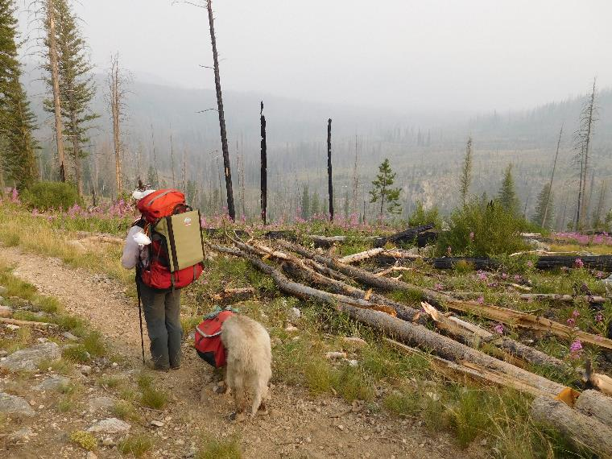
Fig. 24.8: Wildfires Affect Outdoor Recreation
Ch. 24 | Northwest
Wildfires impact outdoor wilderness activities and recreation. Reduced air quality and closed trails and camping grounds are projected to increase as wildfire occurrences increase. Photo credit: Charles Luce.

Slide 15
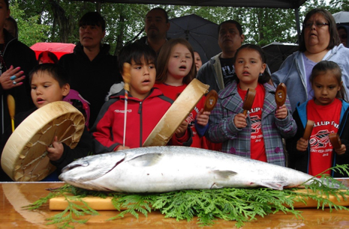
Fig. 24.9: Pacific Salmon and the Identity and Culture of Northwest Tribes
Ch. 24 | Northwest
Pacific salmon are essential to most Northwest Tribes’ identity and culture. Typically, the first salmon caught is displayed, cleaned, and cooked for the community to share. The skeleton is returned to the water to show respect to the salmon. This photo shows the First Salmon ceremony of the Puyallup Tribe. Pacific salmon—a keystone species in the Northwest—are at risk because of climate change. Economic, social, and cultural values are also at risk if salmon populations continue to decline. Recreational salmon fishing contributes to the quality of life and well-being for many Northwest residents. Photo credit: Matt Nagle, Puyallup Tribal News.

Slide 16
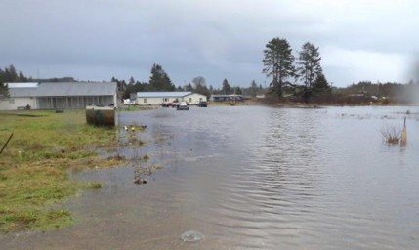
Fig. 24.10: Coastal Flooding in the Quinault Indian Nation
Ch. 24 | Northwest
Coastal floodwaters inundated the Quinault Indian Nation’s lower village of Taholah in March 2014. This event, and continuing concerns about future climate change, prompted the village to begin relocation to higher ground. Photo credit: Michael Cardwell.

Slide 17
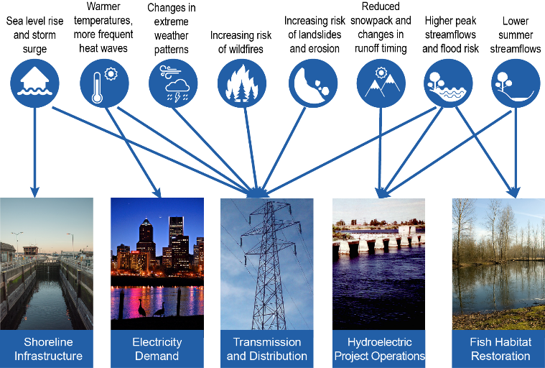
Fig. 24.11: Multiple Climate Stressors Affect Vulnerable Infrastructure
Ch. 24 | Northwest
Extreme events such as floods, heat waves, wildfires, landslides, and drought play an important role in the vulnerability of infrastructure. The figure, from Seattle City Light's Vulnerability Plan,¹³³ illustrates how the utility’s assets, operations, and management goals are affected by a broad range of climate impacts and extreme events. Adaptation strategies to increase the resilience of the energy system must focus on multiple potential risks as well as environmental considerations. Source: adapted from Raymond 2015.¹³³ Photo credits (from left to right): Emmet Anderson (Flickr, CC BY-NC 2.0), Justin Miller (Flickr, CC BY-NC 2.0), photojojo3 (Flickr, CC BY 2.0), U.S. Department of Energy, Rick Swart, Oregon Department of Fish & Wildlife.
Notes:
133: Raymond, C.L., 2015: Seattle City Light Climate Change Vulnerability Assessment and Adaptation Plan. Seattle City Light, Seattle, WA, 97 pp. https://www.seattle.gov/light/enviro/docs/Seattle_City_Light_Climate_Change_Vulnerability_Assessment_and_Adaptation_Plan.pdf

Slide 18
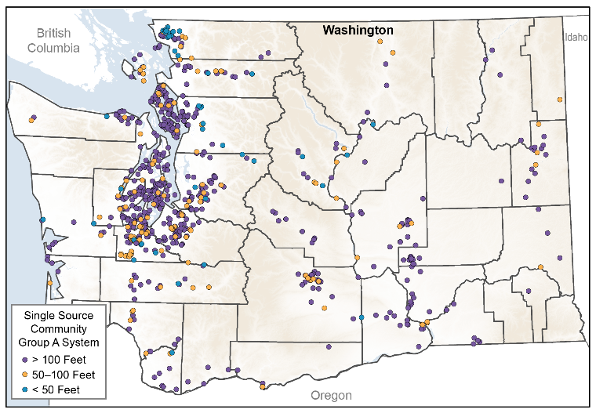
Fig. 24.12: Single-Source Water Systems in Washington
Ch. 24 | Northwest
The map shows public water systems in Washington that are single source, meaning they lack a backup supply, and service at least 25 people per day or have 15 or more connections. Smaller public water systems exist but are not shown. For operators of single source systems, it will likely be particularly difficult to deal with climate-related disruptions such as flooding, drought, and salt water intrusion. Approximate well depth is indicated by color; shallower wells (less than 100 feet in blue and orange) are projected to be more vulnerable to impacts, although aquifer type also influences vulnerability. Although similar impacts will likely occur in Oregon and Idaho, the data are not readily available to assess at a statewide level. Source: Washington Department of Health.

Slide 19
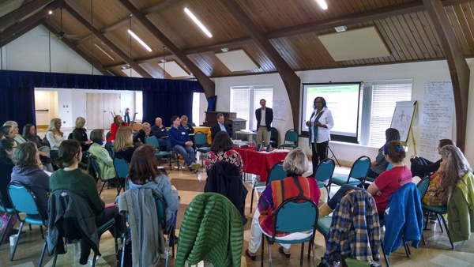
Fig. 24.13: Healthcare Partnerships that Increase Resilience
Ch. 24 | Northwest
Participants at the 2014 Leaders Self-Care Workshop. Photo Credit: The Resource Innovation Group/International Transformational Resilience Coalition.

Slide 20
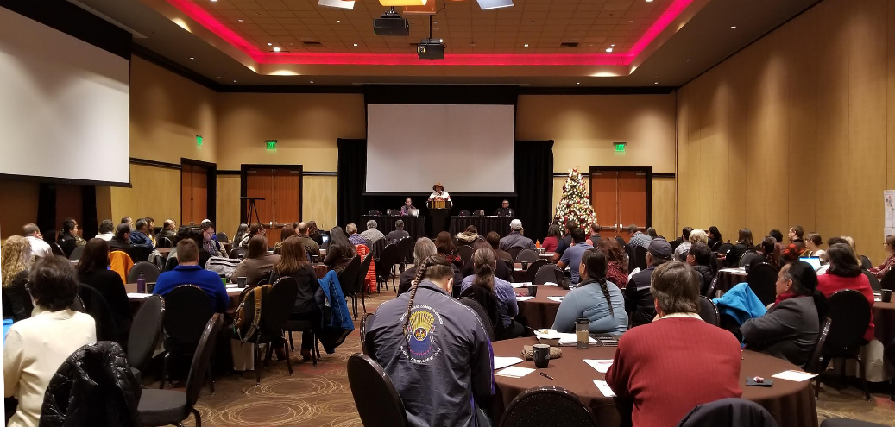
Fig. 24.14: Collaborations Can Use Existing Social Cohesion to Build Resilience
Ch. 24 | Northwest
Social cohesion and social networks can help communities adapt to changing climate conditions. One example is the Pacific Northwest Tribal Climate Change Network. The Network provides a forum for tribes to work together and with, universities, Federal agencies, and private and non-profit organizations to share information, strengthen connections, and build resilience through events such as the 2017 Tribes and First Nations Climate Summit hosted by the Tulalip Tribes and co-sponsored by the Affiliated Tribes of Northwest Indians, the North Pacific Landscape Conservation Cooperative, and the Pacific Northwest Tribal Climate Change Project. Photo credit: Peggy Harris, Affiliated Tribes of Northwest Indians.

Slide 21
Ch. 24 | Northwest
24
Chapter Author Team
Federal Coordinating Lead Author
Charles Luce, USDA Forest Service
Chapter Lead
Christine May, Silvestrum Climate Associates
Chapter Authors
Joe Casola, Climate Impacts Group, University of Washington
Michael Chang, Makah Tribe
Jennifer Cuhaciyan, Bureau of Reclamation
Meghan Dalton, Oregon State University
Scott Lowe, Boise State University
Gary Morishima, Quinault Indian Nation
Philip Mote, Oregon State University
Alexander (Sascha) Petersen, Adaptation International
Gabrielle Roesch-McNally, USDA Forest Service
Emily York, Oregon Health Authority
Review Editor
Beatrice Van Horne, USDA Forest Service, Northwest Climate Hub

Slide 22
Ch. 24 | Northwest
24
Acknowledgments
USGCRP Coordinators
Natalie Bennett, Adaptation and Assessment Analyst
Christopher W. Avery, Senior Manager
Susan Aragon-Long, Senior Scientist

Slide 23
May, C., C. Luce, J. Casola, M. Chang, J. Cuhaciyan, M. Dalton, S. Lowe, G. Morishima, P. Mote, A. Petersen, G. Roesch-McNally, and E. York, 2018: Northwest. In Impacts, Risks, and Adaptation in the United States: Fourth National Climate Assessment, Volume II [Reidmiller, D.R., C.W. Avery, D.R. Easterling, K.E. Kunkel, K.L.M. Lewis, T.K. Maycock, and B.C. Stewart (eds.)]. U.S. Global Change Research Program, Washington, DC, USA. doi: 10.7930/NCA4.2018.CH24
https://nca2018.globalchange.gov/chapter/northwest

