Slide 1
Chapter 21 | Midwest

Slide 2
Ch. 21 | Midwest
21
Key Message #1
Agriculture
The Midwest is a major producer of a wide range of food and animal feed for national consumption and international trade. Increases in warm-season absolute humidity and precipitation have eroded soils, created favorable conditions for pests and pathogens, and degraded the quality of stored grain. Projected changes in precipitation, coupled with rising extreme temperatures before mid-century, will reduce Midwest agricultural productivity to levels of the 1980s without major technological advances.

Slide 3
Ch. 21 | Midwest
21
Key Message #2
Forestry
Midwest forests provide numerous economic and ecological benefits, yet threats from a changing climate are interacting with existing stressors such as invasive species and pests to increase tree mortality and reduce forest productivity. Without adaptive actions, these interactions will result in the loss of economically and culturally important tree species such as paper birch and black ash and are expected to lead to the conversion of some forests to other forest types or even to non-forested ecosystems by the end of the century. Land managers are beginning to manage risk in forests by increasing diversity and selecting for tree species adapted to a range of projected conditions.

Slide 4
Ch. 21 | Midwest
21
Key Message #3
Biodiversity and Ecosystems
The ecosystems of the Midwest support a diverse array of native species and provide people with essential services such as water purification, flood control, resource provision, crop pollination, and recreational opportunities. Species and ecosystems, including the important freshwater resources of the Great Lakes, are typically most at risk when climate stressors, like temperature increases, interact with land-use change, habitat loss, pollution, nutrient inputs, and nonnative invasive species. Restoration of natural systems, increases in the use of green infrastructure, and targeted conservation efforts, especially of wetland systems, can help protect people and nature from climate change impacts.

Slide 5
Ch. 21 | Midwest
21
Key Message #4
Human Health
Climate change is expected to worsen existing health conditions and introduce new health threats by increasing the frequency and intensity of poor air quality days, extreme high temperature events, and heavy rainfalls; extending pollen seasons; and modifying the distribution of disease-carrying pests and insects. By mid-century, the region is projected to experience substantial, yet avoidable, loss of life, worsened health conditions, and economic impacts estimated in the billions of dollars as a result of these changes. Improved basic health services and increased public health measures—including surveillance and monitoring—can prevent or reduce these impacts.

Slide 6
Ch. 21 | Midwest
21
Key Message #5
Transportation and Infrastructure
Storm water management systems, transportation networks, and other critical infrastructure are already experiencing impacts from changing precipitation patterns and elevated flood risks. Green infrastructure is reducing some of the negative impacts by using plants and open space to absorb storm water. The annual cost of adapting urban storm water systems to more frequent and severe storms is projected to exceed $500 million for the Midwest by the end of the century.

Slide 7
Ch. 21 | Midwest
21
Key Message #6
Community Vulnerability and Adaptation
At-risk communities in the Midwest are becoming more vulnerable to climate change impacts such as flooding, drought, and increases in urban heat islands. Tribal nations are especially vulnerable because of their reliance on threatened natural resources for their cultural, subsistence, and economic needs. Integrating climate adaptation into planning processes offers an opportunity to better manage climate risks now. Developing knowledge for decision-making in cooperation with vulnerable communities and tribal nations will help to build adaptive capacity and increase resilience.

Slide 8
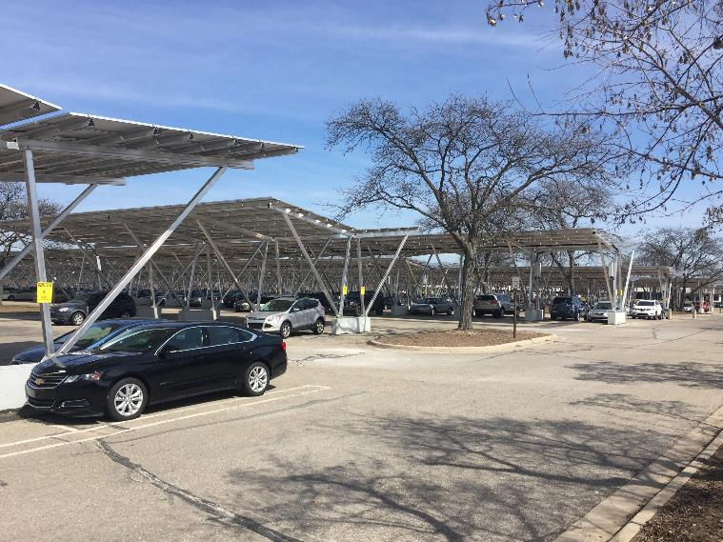
Fig. 21.1: Solar Carports
Ch. 21 | Midwest
Solar carports were recently installed on the Michigan State University campus. Photo credit: David Rothstein.

Slide 9
Table 21.1: Average Annual 5-Day Maximum Temperature
Ch. 21 | Midwest
Geographic Area | Modeled Historical (1976–2005) | Mid-21st Century (2036–2065) for Lower Scenario (RCP4.5) | Mid-21st Century (2036–2065) for Higher Scenario (RCP8.5)
Northern Minnesota | 88°F | 93°F | 95°F
Southern Missouri | 97°F | 102°F | 103°F
These modeled historical and projected average annual 5-day maximum temperatures illustrate the temperature increases projected for the middle of this century across the Midwest. Sources: NOAA NCEI and CICS-NC.

Slide 10
Table 21.2: Optimum and Failure Temperatures for Vegetative Growth and Reproduction
Ch. 21 | Midwest
Crop | Optimum Growth | Failure for Growth | Optimum Reproduction | Failure for Reproduction
Corn | 80°F | 105°F | 67°F | 95°F
Soybean | 86°F | 101°F | 72°F | 102°F
This table shows the temperatures at which corn and soybeans reach optimum growth and reproduction as well as the temperatures at which growth and reproduction fail.⁵⁰
Notes:
50: Hatfield, J.L., K.J. Boote, B.A. Kimball, L.H. Ziska, R.C. Izaurralde, D. Ort, A.M. Thomson, and D. Wolfe, 2011: Climate impacts on agriculture: Implications for crop production. Agronomy Journal, 103 (2), 351-370. http://dx.doi.org/10.2134/agronj2010.0303

Slide 11
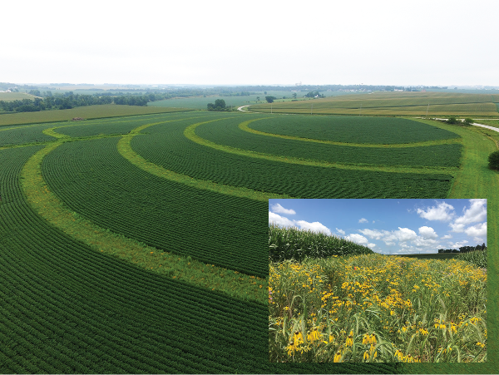
Fig. 21.2: Conservation Practices Reduce Impact of Heavy Rains
Ch. 21 | Midwest
Integrating strips of native prairie vegetation into row crops has been shown to reduce sediment and nutrient loss from fields, as well as improve biodiversity and the delivery of ecosystem services.³³ Iowa State University's STRIPS program is actively conducting research into this agricultural conservation practice.³⁴ The inset shows a close-up example of a prairie vegetation strip. Photo credits: (main photo) Lynn Betts, (inset) Farnaz Kordbacheh.
Notes:
33: Schulte, L.A., J. Niemi, M.J. Helmers, M. Liebman, J.G. Arbuckle, D.E. James, R.K. Kolka, M.E. O’Neal, M.D. Tomer, J.C. Tyndall, H. Asbjornsen, P. Drobney, J. Neal, G. Van Ryswyk, and C. Witte, 2017: Prairie strips improve biodiversity and the delivery of multiple ecosystem services from corn–soybean croplands. Proceedings of the National Academy of Sciences of the United States of America, 114 (42), 11247-11252. http://dx.doi.org/10.1073/pnas.1620229114
34: ISU, 2018: STRIPS (Science-based Trials of Rowcrops Integrated with Prairie Strips) Project [web site]. Iowa State University (ISU), Ames, IA. https://www.nrem.iastate.edu/research/STRIPS/

Slide 12
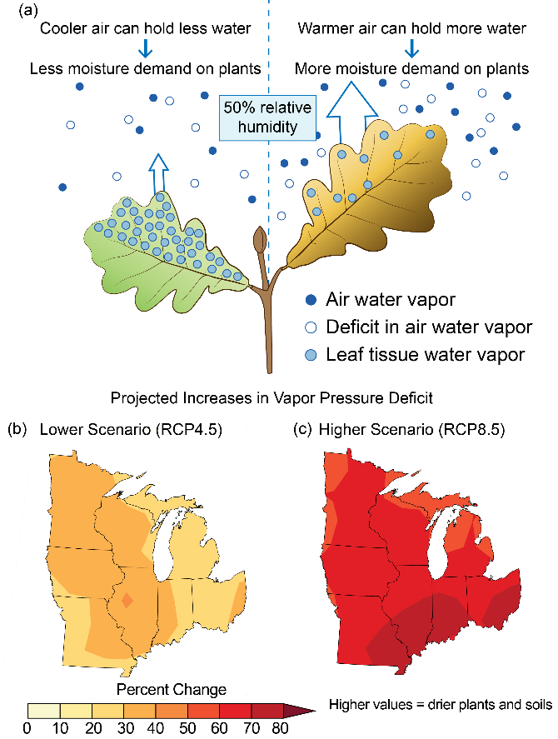
Fig. 21.3: Drying Effect of Warmer Air on Plants and Soils
Ch. 21 | Midwest
As air temperature increases in a warming climate, vapor pressure deficit (VPD) is projected to increase. VPD is the difference between how much moisture is in the air and the amount of moisture in the air at saturation (at 100% relative humidity). Increased VPD has a drying effect on plants and soils, as moisture transpires (from plants) and evaporates (from soil) into the air. (a) Cooler air can maintain less water as vapor, putting less demand for moisture on plants, while warmer air can maintain more water as vapor, putting more demand for moisture on plants. (b, c) The maps show the percent change in the moisture deficit of the air based on the projected maximum 5-day VPD by the late 21st century (2070–2099) compared to 1976–2005 for (b) lower and (c) higher scenarios (RCP4.5 and RCP8.5). Sources: U.S. Forest Service, NOAA NCEI, and CICS-NC.

Slide 13
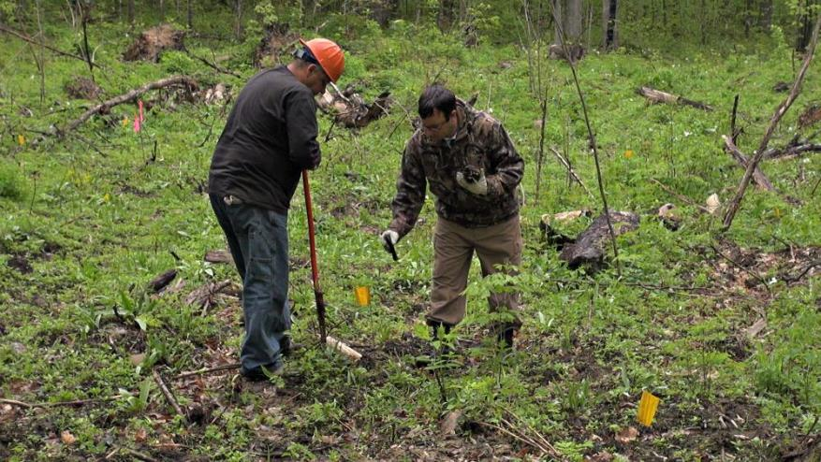
Fig. 21.4: Forest Diversity Can Increase Resilience to Climate Change
Ch. 21 | Midwest
The photo shows Menominee Tribal Enterprises staff creating opportunity from adversity by replanting a forest opening caused by oak wilt disease with a diverse array of tree and understory plant species that are expected to fare better under future climate conditions. Photo credit: Kristen Schmitt.

Slide 14
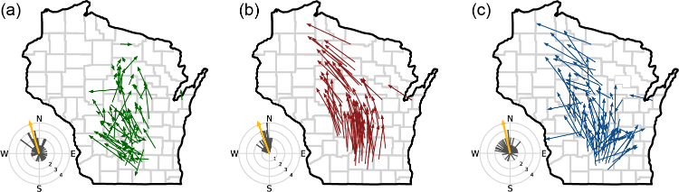
Fig. 21.5: Climate Change Outpaces Plants’ Ability to Shift Habitat Range
Ch. 21 | Midwest
While midwestern species, such as understory plants in Wisconsin, are showing changes in range, they may not be shifting quickly enough to keep up with changes in climate. The panels here represent 78 plant species, showing (a) observed changes in the center of plant species abundances (centroids) from the 1950s to 2000s, (b) the direction and magnitude of changes in climate factors associated with those species, and (c) the lag, or difference, between where the species centroid is now located and where the change in climate factors suggests it should be located in order to keep pace with a changing climate. Source: adapted from Ash et al. 2017.¹⁴¹ ©John Wiley & Sons, Ltd.
Notes:
141: Ash, J.D., T.J. Givnish, and D.M. Waller, 2017: Tracking lags in historical plant species’ shifts in relation to regional climate change. Global Change Biology, 23 (3), 1305-1315. http://dx.doi.org/10.1111/gcb.13429

Slide 15
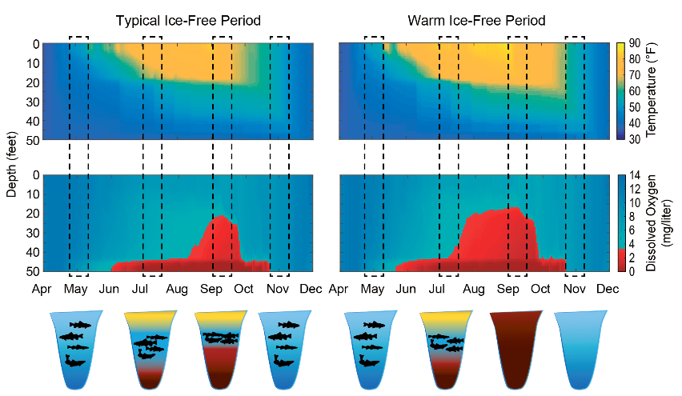
Fig. 21.6: Coldwater Fish at Risk
Ch. 21 | Midwest
The graphic shows the oxythermal (oxygen and temperature) habitat of coldwater fish in midwestern inland lakes, illustrated by water depth under (left) a typical ice-free period and (right) a warm ice-free period (right). The top plots show water temperatures during the ice-free period, and the bottom plots show the dissolved oxygen concentrations. The schematics at the bottom illustrate the area of the lake that is ideal habitat for coldwater fish (in blue) and areas that represent water outside of the temperature or dissolved oxygen limit (in yellow and red, respectively). The left plots show how available habitat “squeezes” during a typical year, while the right plots illustrate a complete loss of suitable habitat during very warm years. Source: Madeline Magee, University of Wisconsin.

Slide 16
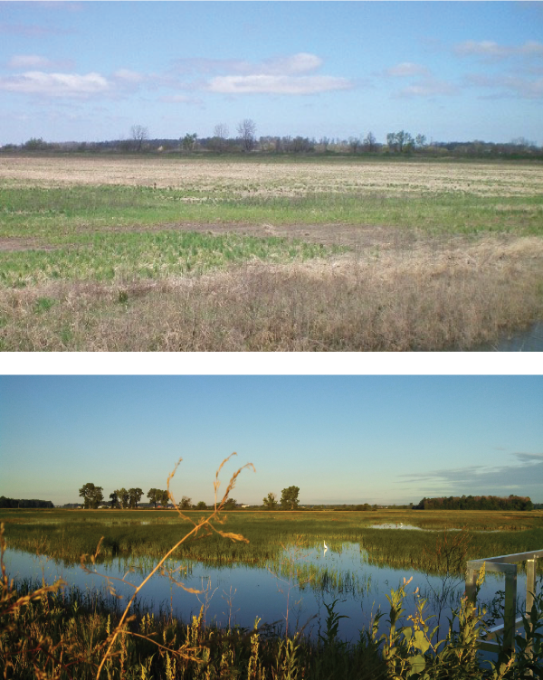
Fig. 21.7: Wetland Restoration Projects Can Help Reduce Impacts
Ch. 21 | Midwest
The Blausey Tract restoration project on the U.S. Fish and Wildlife Service’s Ottawa National Wildlife Refuge (Ohio) restored 100 acres of former Lake Erie coastal wetlands that were previously in row crop production. In addition to providing habitat for wildlife and fish, these wetlands help reduce climate change impacts by storing water from high-water events and by filtering nutrients and sediments out of water pumped from an adjacent farm ditch. This work was carried out by two conservation groups, The Nature Conservancy and Ducks Unlimited, in partnership with the U.S. Fish and Wildlife Service, and was funded by The Great Lakes Restoration Initiative.^{186,187} (top) Shown here is the Blausey Tract restoration site in early spring of 2011, prior to the restoration activities. (bottom) In the spring of 2013, just two years after the start of restoration, the site already was providing important habitat for wildlife and fish. Photo credits: (top) ©The Nature Conservancy, (bottom) Bill Stanley, ©The Nature Conservancy.
Notes:
186: Dierkes, C., 2012: From farm fields to wetlands. Twine Line, 34 (4), 3-5. https://ohioseagrant.osu.edu/p/3un80
187: Staff Writer, 2015: Country Life: Wetland rehabilitation effort paying off. Ohio Ag Net, September 30. Agri Communicators Inc., Columbus, OH. http://ocj.com/2015/09/wetland-rehabilitation-effort-paying-off/

Slide 17
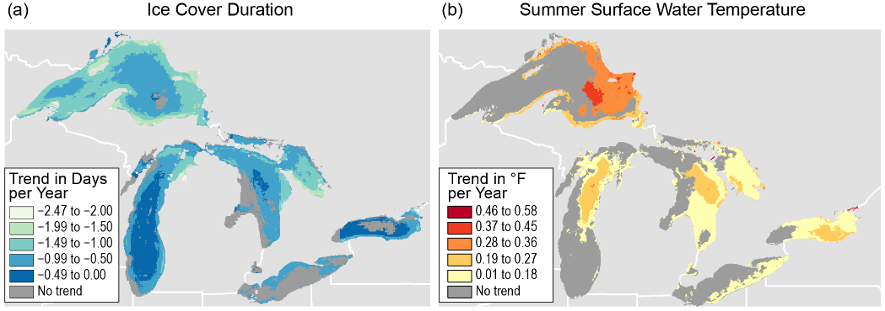
Fig. 21.8: The Changing Great Lakes
Ch. 21 | Midwest
The duration of seasonal ice cover decreased in most areas of the Great Lakes between 1973 and 2013, while summer surface water temperature (SWT) increased in most areas between 1994 and 2013. (a) The map shows the rate of change in ice cover duration. The greatest rate of decrease in seasonal ice cover duration is seen near shorelines, with smaller rates occurring in the deeper central parts of Lakes Michigan and Ontario, which rarely have ice cover. (b) The map shows the rate of change in summer SWT. The greatest rates of increase in summer SWT occurred in deeper water, with smaller increases occurring near shorelines. Source: adapted from Mason et al. 2016.¹⁹² Used with permission from Springer.
Notes:
192: Mason, L.A., C.M. Riseng, A.D. Gronewold, E.S. Rutherford, J. Wang, A. Clites, S.D.P. Smith, and P.B. McIntyre, 2016: Fine-scale spatial variation in ice cover and surface temperature trends across the surface of the Laurentian Great Lakes. Climatic Change, 138 (1), 71-83. http://dx.doi.org/10.1007/s10584-016-1721-2

Slide 18
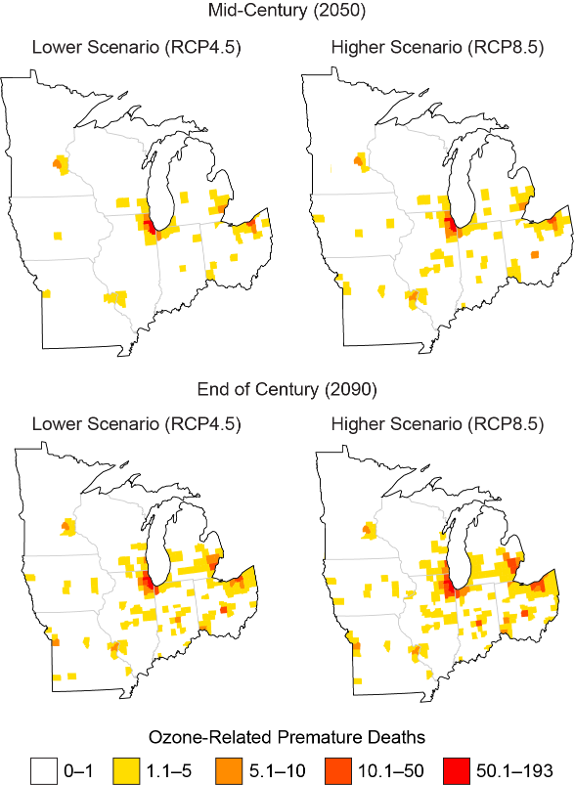
Fig. 21.9: Projected Changes in Ozone-Related Premature Deaths
Ch. 21 | Midwest
Maps show county-level estimates for the change in average annual ozone-related premature deaths over the summer months in 2050 (2045–2055) and 2090 (2085–2095) compared to 2000 (1995–2005) under the lower and higher scenarios (RCP4.5 and RCP8.5) in the Midwest. The results represent the average of five global climate models. Source: adapted from EPA 2017.²⁸
Notes:
28: EPA, 2017: Multi-model Framework for Quantitative Sectoral Impacts Analysis: A Technical Report for the Fourth National Climate Assessment. EPA 430‐R‐17‐001. U.S. Environmental Protection Agency (EPA), Washington, DC, 271 pp. https://cfpub.epa.gov/si/si_public_record_Report.cfm?dirEntryId=335095

Slide 19
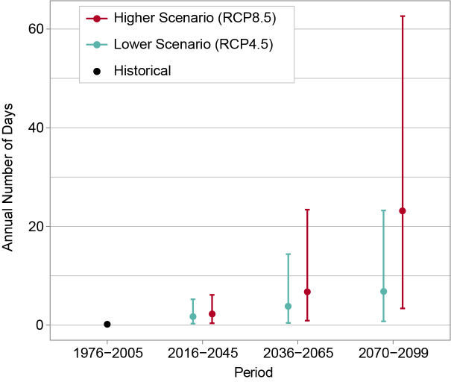
Fig. 21.10: Days Above 100°F for Chicago
Ch. 21 | Midwest
This graph shows the annual number of days above 100°F in Chicago for the historical period of 1976–2005 (black dot) and projected throughout the 21st century under lower (RCP4.5, teal) and higher (RCP8.5, red) scenarios. Increases at the higher end of these ranges would pose major heat-related health problems for people in Chicago. As shown by the black dot, the average number of days per year above 100°F for 1976–2005 was essentially zero. By the end of the century (2070–2099), the projected number of these very hot days ranges from 1 to 23 per year under the lower scenario and 3 to 63 per year under the higher scenario. For the three future periods, the teal and red dots represent the model-weighted average for each scenario, while the vertical lines represent the range of values (5th to 95th percentile). Both scenarios show an increasing number of days over 100°F with time but increasing at a faster rate under the higher scenario. Sources: NOAA NCEI and CICS-NC.

Slide 20
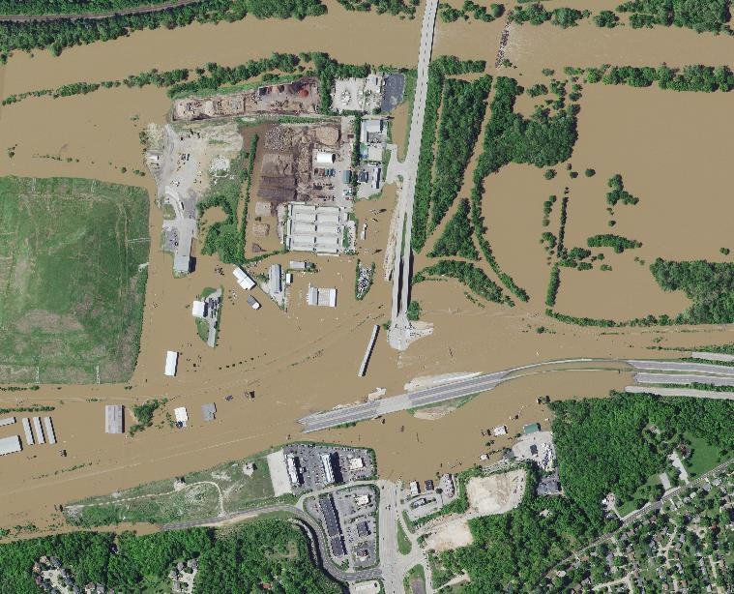
Fig. 21.11: Meramec River Flooding
Ch. 21 | Midwest
This composite image shows portions of Interstate 44 near St. Louis that were closed by Meramec River flooding in both 2015 and 2017. The flooding shown here occurred in May 2017. Image credit: Surdex Corporation.

Slide 21
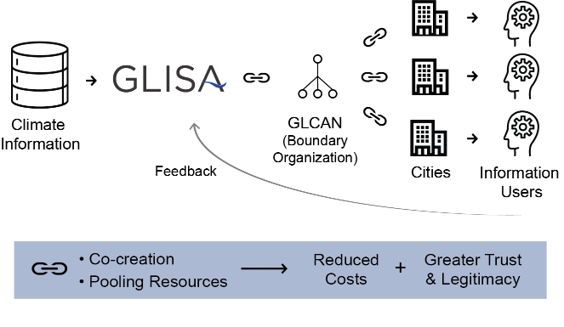
Fig. 21.12: Linked Boundary Chain Model
Ch. 21 | Midwest
Shown here is a configuration of the boundary chain employed in the Great Lakes Climate Adaptation Network (GLCAN) Case Study. The information is tailored and moves through different boundary organizations (links in the chain) to connect science to users. By co-creating information and pooling resources throughout the chain, trust and legitimacy are built and cost is decreased. Source: adapted from Lemos et al. 2014.²⁹⁴ ©American Meteorological Society
Notes:
294: Lemos, M.C., C.J. Kirchhoff, S.E. Kalafatis, D. Scavia, and R.B. Rood, 2014: Moving climate information off the shelf: Boundary chains and the role of RISAs as adaptive organizations. Weather, Climate, and Society, 6 (2), 273-285. http://dx.doi.org/10.1175/WCAS-D-13-00044.1

Slide 22
Ch. 21 | Midwest
21
Chapter Author Team
Federal Coordinating Lead Author
Chris Swanston, USDA Forest Service
Chapter Lead
Jim Angel, Prairie Research Institute, University of Illinois
Chapter Authors
Barbara Mayes Boustead, National Oceanic and Atmospheric Administration
Kathryn C. Conlon, Centers for Disease Control and Prevention
Kimberly R. Hall, The Nature Conservancy
Jenna L. Jorns, University of Michigan, Great Lakes Integrated Sciences and Assessments
Kenneth E. Kunkel, North Carolina State University
Maria Carmen Lemos, University of Michigan, Great Lakes Integrated Sciences and Assessments
Brent Lofgren, National Oceanic and Atmospheric Administration
Todd A. Ontl, USDA Forest Service, Northern Forests Climate Hub
John Posey, East West Gateway Council of Governments
Kim Stone, Great Lakes Indian Fish and Wildlife Commissions (through January 2018)
Eugene Takle, Iowa State University
Dennis Todey, USDA, Midwest Climate Hub
Review Editor
Thomas Bonnot, University of Missouri

Slide 23
Ch. 21 | Midwest
21
Acknowledgments
Technical Contributors
Katherine Browne, University of Michigan
Melonee Montano, Great Lakes Indian Fish and Wildlife Commission
Hannah Panci, Great Lakes Indian Fish and Wildlife Commission
Jason Vargo, University of Wisconsin
Madeline R. Magee, University of Wisconsin-Madison
USGCRP Coordinators
Kristin Lewis, Senior Scientist
Allyza Lustig, Program Coordinator

Slide 24
Angel, J., C. Swanston, B.M. Boustead, K.C. Conlon, K.R. Hall, J.L. Jorns, K.E. Kunkel, M.C. Lemos, B. Lofgren, T.A. Ontl, J. Posey, K. Stone, G. Takle, and D. Todey, 2018: Midwest. In Impacts, Risks, and Adaptation in the United States: Fourth National Climate Assessment, Volume II [Reidmiller, D.R., C.W. Avery, D.R. Easterling, K.E. Kunkel, K.L.M. Lewis, T.K. Maycock, and B.C. Stewart (eds.)]. U.S. Global Change Research Program, Washington, DC, USA. doi: 10.7930/NCA4.2018.CH21
https://nca2018.globalchange.gov/chapter/midwest

