Slide 1
Chapter 11 | Built Environment, Urban Systems, and Cities

Slide 2
Ch. 11 | Built Environment, Urban Systems, and Cities
11
Key Message #1
Impacts on Urban Quality of Life
The opportunities and resources in urban areas are critically important to the health and well-being of people who work, live, and visit there. Climate change can exacerbate existing challenges to urban quality of life, including social inequality, aging and deteriorating infrastructure, and stressed ecosystems. Many cities are engaging in creative problem solving to improve quality of life while simultaneously addressing climate change impacts.

Slide 3
Ch. 11 | Built Environment, Urban Systems, and Cities
11
Key Message #2
Forward-Looking Design for Urban Infrastructure
Damages from extreme weather events demonstrate current urban infrastructure vulnerabilities. With its long service life, urban infrastructure must be able to endure a future climate that is different from the past. Forward-looking design informs investment in reliable infrastructure that can withstand ongoing and future climate risks.

Slide 4
Ch. 11 | Built Environment, Urban Systems, and Cities
11
Key Message #3
Impacts on Urban Goods and Services
Interdependent networks of infrastructure, ecosystems, and social systems provide essential urban goods and services. Damage to such networks from current weather extremes and future climate will adversely affect urban life. Coordinated local, state, and federal efforts can address these interconnected vulnerabilities.

Slide 5
Ch. 11 | Built Environment, Urban Systems, and Cities
11
Key Message #4
Urban Response to Climate Change
Cities across the United States are leading efforts to respond to climate change. Urban adaptation and mitigation actions can affect current and projected impacts of climate change and provide near-term benefits. Challenges to implementing these plans remain. Cities can build on local knowledge and risk management approaches, integrate social equity concerns, and join multicity networks to begin to address these challenges.

Slide 6
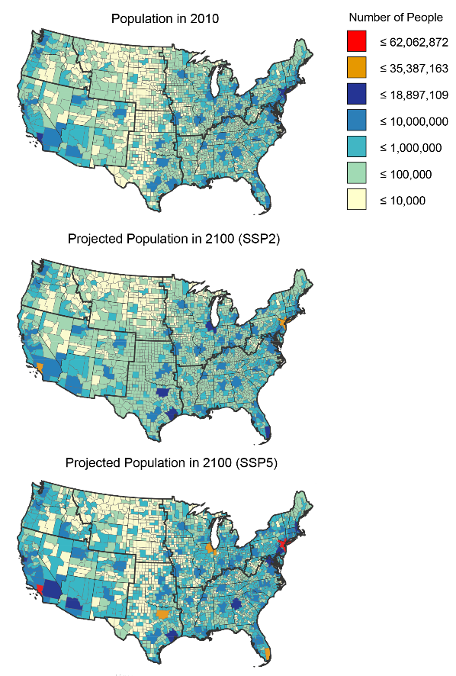
Fig. 11.1: Current and Projected U.S. Population
Ch. 11 | Built Environment, Urban Systems, and Cities
These maps show current population along with population projections by county for the year 2100. Projected populations are based on Shared Socioeconomic Pathways (SSPs)—a collection of plausible future pathways of socioeconomic development.⁸ The middle map is based on demography consistent with the SSP2, which follows a middle-of-the-road path where trends do not shift markedly from historical patterns. The bottom map uses demography consistent with SSP5, which follows a more rapid technical progress and resource-intensive development path. Increasing urban populations pose challenges to planners and city managers as they seek to maintain and improve urban environments. Data are unavailable for the U.S. Caribbean, Alaska, and Hawai‘i & U.S.-Affiliated Pacific Islands regions. Source: EPA.
Notes:
8: Hayhoe, K., J. Edmonds, R.E. Kopp, A.N. LeGrande, B.M. Sanderson, M.F. Wehner, and D.J. Wuebbles, 2017: Climate models, scenarios, and projections. Climate Science Special Report: Fourth National Climate Assessment, Volume I. Wuebbles, D.J., D.W. Fahey, K.A. Hibbard, D.J. Dokken, B.C. Stewart, and T.K. Maycock, Eds. U.S. Global Change Research Program, Washington, DC, USA, 133-160. http://dx.doi.org/10.7930/J0WH2N54

Slide 7
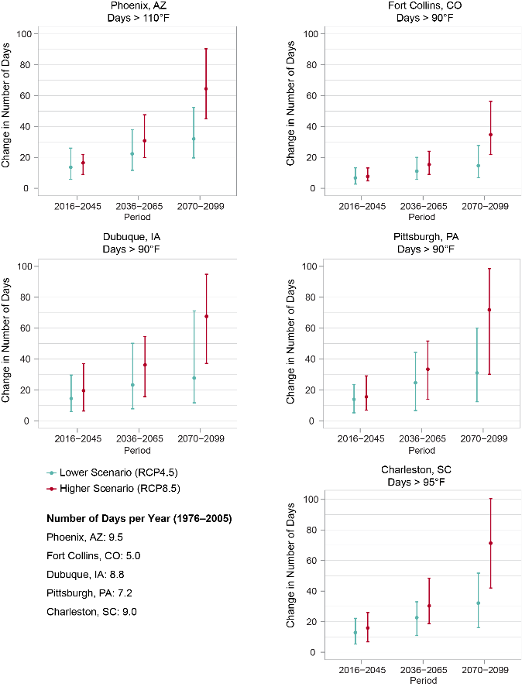
Fig. 11.2: Projected Change in the Number of Very Hot Days
Ch. 11 | Built Environment, Urban Systems, and Cities
Projected increases in the number of very hot days (compared to the 1976–2005 average) are shown for each of five U.S. cities under lower (RCP4.5) and higher (RCP8.5) scenarios. Here, very hot days are defined as those on which the daily high temperature exceeds a threshold value specific to each of the five U.S. cities shown. Dots represent the modeled median (50th percentile) values, and the vertical bars show the range of values (5th to 95th percentile) from the models used in the analysis. Modeled historical values are shown for the same temperature thresholds, for the period 1976–2005, in the lower left corner of the figure. These and other U.S. cities are projected to see an increase in the number of very hot days over the rest of this century under both scenarios, affecting people, infrastructure, green spaces, and the economy. Increased air conditioning and energy demands raise utility bills and can lead to power outages and blackouts. Hot days can degrade air and water quality, which in turn can harm human health and decrease quality of life. Sources: NOAA NCEI, CICS-NC, and LMI

Slide 8
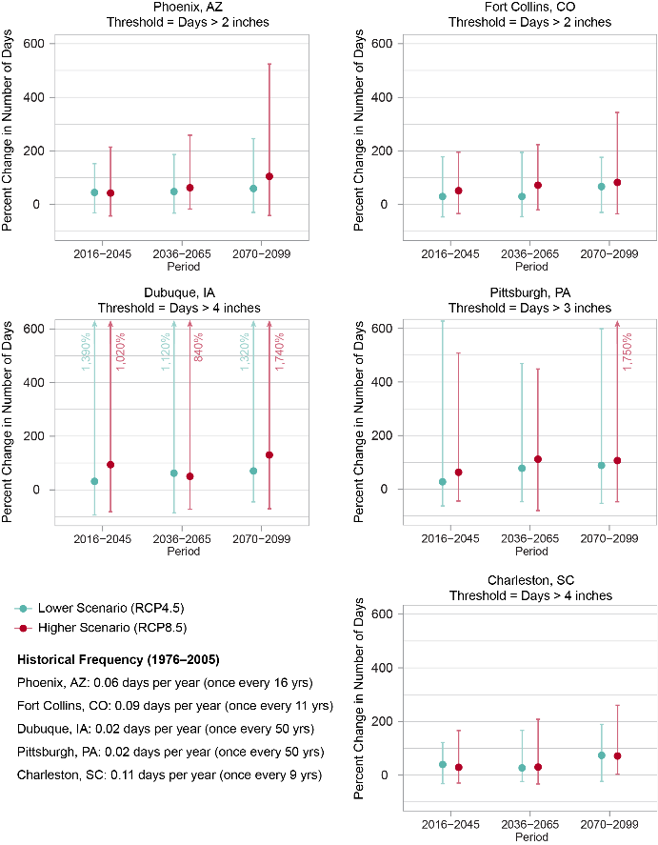
Fig. 11.3: Projected Change in the Number of Days with Heavy Precipitation
Ch. 11 | Built Environment, Urban Systems, and Cities
Many U.S. cities are projected to see more days with heavy precipitation, increasing the risk of urban flooding, especially in areas with a lot of paved surfaces. Projections of percent changes in the number of days with heavy precipitation (compared to the 1976–2005 average) are shown for five U.S. cities under lower (RCP4.5) and higher (RCP8.5) scenarios. Here, days with heavy precipitation are defined as those on which the amount of total precipitation exceeds a threshold value specific to each city. Dots represent the modeled median (50th percentile) values, and the vertical bars show the range of values (5th to 95th percentile) from the models used in the analysis. Modeled historical values are shown for the same thresholds, for the period 1976–2005, in the lower left corner of the figure. Historical values are given in terms of frequency (days per year) and return period (average number of years between events). Sources: NOAA NCEI, CICS-NC, and LMI.

Slide 9
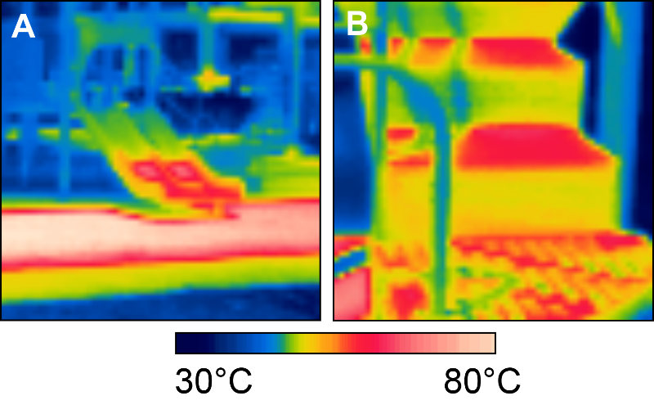
Fig. 11.4: Threats from Extreme Heat
Ch. 11 | Built Environment, Urban Systems, and Cities
These images show surface temperatures of playground equipment in metropolitan Phoenix, Arizona. Children are particularly susceptible to high heat¹² and can be exposed through daily activities. (A) A slide and dark rubber surface in the sun (orange/red colors) are shown reaching temperatures of 71°C (160°F) and 82°C (180°F), respectively. The blue/green colors are under a shade sail. (B) Playground steps made of black powder-coated metal are shown reaching a temperature of 58°C (136°F) in the direct sunlight. Images use infrared thermography and were taken mid-day on September 15, 2014. Credit: Vanos et al. 2016.⁴⁹
Notes:
12: USGCRP, 2016: The Impacts of Climate Change on Human Health in the United States: A Scientific Assessment.U.S. Global Change Research Program, Washington, DC, 312 pp. http://dx.doi.org/10.7930/J0R49NQX
49: Vanos, J.K., A. Middel, G.R. McKercher, E.R. Kuras, and B.L. Ruddell, 2016: Hot playgrounds and children’s health: A multiscale analysis of surface temperatures in Arizona, USA. Landscape and Urban Planning,146, 29-42. http://dx.doi.org/10.1016/j.landurbplan.2015.10.007

Slide 10
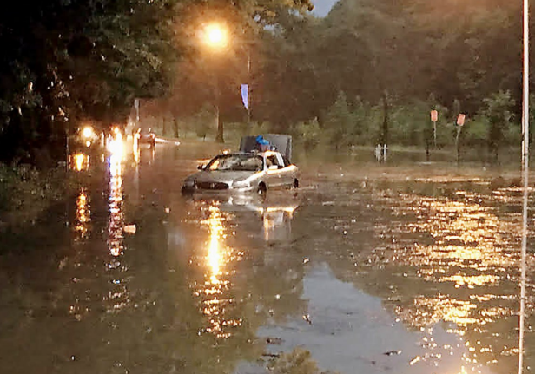
Fig. 11.5: Flash Flooding Impacts Urban Infrastructure and Well-Being
Ch. 11 | Built Environment, Urban Systems, and Cities
Flash flooding overwhelmed drainage systems and swamped roadways in Pittsburgh, Pennsylvania, in 2011. The flooding disrupted businesses and commutes, damaged homes, and caused four deaths. Photo credit: Pittsburgh Post-Gazette.

Slide 11
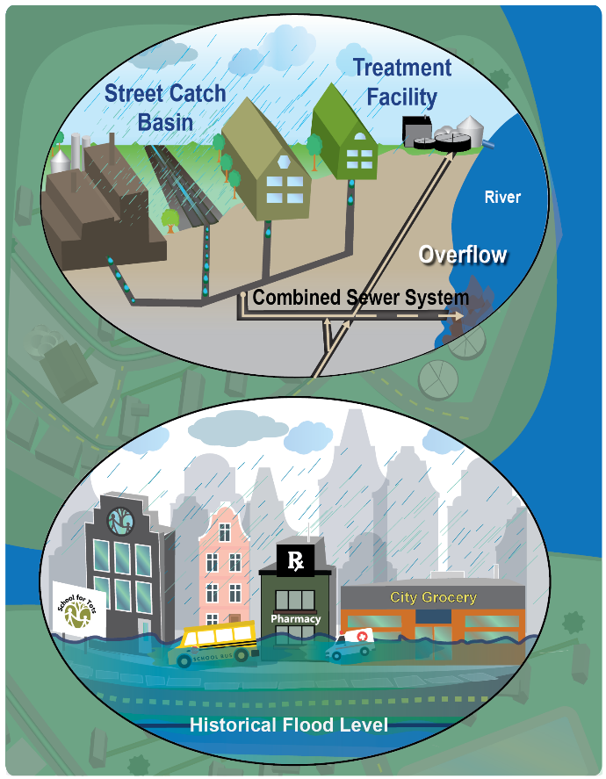
Fig. 11.6: Cascading Consequences of Heavy Rainfall for Urban Systems
Ch. 11 | Built Environment, Urban Systems, and Cities
With heavy downpours increasing nationally, urban areas experience costly impacts. (top) In cities with combined sewer systems, storm water runoff flows into pipes containing sewage from homes and industrial wastewater. Intense rainfall can overwhelm the system so untreated wastewater overflows into rivers. Overflows are a water pollution concern and increase risk of exposure to waterborne diseases. (bottom) Intense rainfall can also result in localized flooding. Closed roads and disrupted mass transit prevent residents from going to work or school and first responders from reaching those in need. Home and commercial property owners may need to make costly repairs, and businesses may lose revenue. Source: EPA.

Slide 12
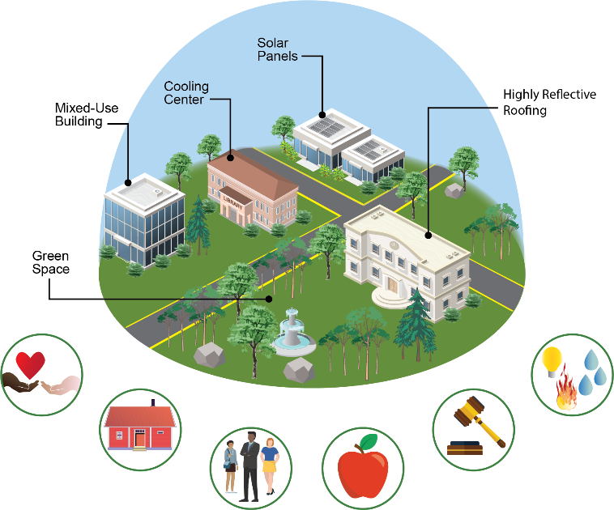
Fig. 11.7: Urban Adaptation Strategies and Stakeholders
Ch. 11 | Built Environment, Urban Systems, and Cities
Protecting vulnerable people and places from the impacts of climate change involves infrastructure design (for example, green space and highly reflective roofing), along with social and institutional change (such as designating cooling centers). Social equity is supported by widespread participation in adaptation decision-making by non-profit organizations, local businesses, vulnerable populations, school districts, city governments, utility providers, and others. Source: EPA.

Slide 13
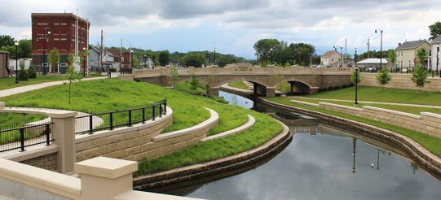
Fig. 11.8: Greenway in Dubuque, Iowa
Ch. 11 | Built Environment, Urban Systems, and Cities
In response to a history of flooding, Dubuque, Iowa, installed the Bee Branch Creek Greenway to control flooding and provide recreational space.¹³⁸ Photo credit: City of Dubuque, Iowa.
Notes:
138: City of Dubuque, 2017: Upper Bee Branch Creek Restoration, Dubuque, IA, accessed
August 1. http://www.cityofdubuque.org/1546/Upper-Bee-Branch-Creek-Restoration

Slide 14
Ch. 11 | Built Environment, Urban Systems, and Cities
11
Chapter Author Team
Federal Coordinating Lead Author
Susan Julius, U.S. Environmental Protection Agency
Chapter Lead
Keely Maxwell, U.S. Environmental Protection Agency
Chapter Authors
Anne Grambsch, U.S. Environmental Protection Agency (Retired)
Ann Kosmal, U.S. General Services Administration
Libby Larson, National Aeronautics and Space Administration
Nancy Sonti, U.S. Forest Service
Review Editor
Jesse Keenan, Harvard University

Slide 15
Ch. 11 | Built Environment, Urban Systems, and Cities
11
Acknowledgments
Technical Contributors
Julie Blue, Eastern Research Group, Inc.
Kevin Bush, U.S. Department of Housing and Urban Development (through August 2017)
USGCRP Coordinators
Natalie Bennett, Adaptation and Assessment Analyst
Fredric Lipschultz, Senior Scientist and Regional Coordinator

Slide 16
Maxwell, K., S. Julius, A. Grambsch, A. Kosmal, L. Larson, and N. Sonti, 2018: Built Environment, Urban Systems, and Cities. In Impacts, Risks, and Adaptation in the United States: Fourth National Climate Assessment, Volume II [Reidmiller, D.R., C.W. Avery, D.R. Easterling, K.E. Kunkel, K.L.M. Lewis, T.K. Maycock, and B.C. Stewart (eds.)]. U.S. Global Change Research Program, Washington, DC, USA. doi: 10.7930/NCA4.2018.CH11
https://nca2018.globalchange.gov/chapter/built-environment

