Slide 1
Chapter 27 | Hawai‘i and U.S.-Affiliated Pacific Islands

Slide 2
Ch. 27 | Hawai‘i and U.S.-Affiliated Pacific Islands
27
Key Message #1
Threats to Water Supplies
Dependable and safe water supplies for Pacific island communities and ecosystems are threatened by rising temperatures, changing rainfall patterns, sea level rise, and increased risk of extreme drought and flooding. Islands are already experiencing saltwater contamination due to sea level rise, which is expected to catastrophically impact food and water security, especially on low-lying atolls. Resilience to future threats relies on active monitoring and management of watersheds and freshwater systems.

Slide 3
Ch. 27 | Hawai‘i and U.S.-Affiliated Pacific Islands
27
Key Message #2
Terrestrial Ecosystems, Ecosystem Services, and Biodiversity
Pacific island ecosystems are notable for the high percentage of species found only in the region, and their biodiversity is both an important cultural resource for island people and a source of economic revenue through tourism. Terrestrial habitats and the goods and services they provide are threatened by rising temperatures, changes in rainfall, increased storminess, and land-use change. These changes promote the spread of invasive species and reduce the ability of habitats to support protected species and sustain human communities. Some species are expected to become extinct and others to decline to the point of requiring protection and costly management.

Slide 4
Ch. 27 | Hawai‘i and U.S.-Affiliated Pacific Islands
27
Key Message #3
Coastal Communities and Systems
The majority of Pacific island communities are confined to a narrow band of land within a few feet of sea level. Sea level rise is now beginning to threaten critical assets such as ecosystems, cultural sites and practices, economies, housing and energy, transportation, and other forms of infrastructure. By 2100, increases of 1–4 feet in global sea level are very likely, with even higher levels than the global average in the U.S.-Affiliated Pacific Islands. This would threaten the food and freshwater supply of Pacific island populations and jeopardize their continued sustainability and resilience. As sea level rise is projected to accelerate strongly after mid-century, adaptation strategies that are implemented sooner can better prepare communities and infrastructure for the most severe impacts.

Slide 5
Ch. 27 | Hawai‘i and U.S.-Affiliated Pacific Islands
27
Key Message #4
Oceans and Marine Resources
Fisheries, coral reefs, and the livelihoods they support are threatened by higher ocean temperatures and ocean acidification. Widespread coral reef bleaching and mortality have been occurring more frequently, and by mid-century these events are projected to occur annually, especially if current trends in emissions continue. Bleaching and acidification will result in loss of reef structure, leading to lower fisheries yields and loss of coastal protection and habitat. Declines in oceanic fishery productivity of up to 15% and 50% of current levels are projected by mid-century and 2100, respectively, under the higher scenario (RCP8.5).

Slide 6
Ch. 27 | Hawai‘i and U.S.-Affiliated Pacific Islands
27
Key Message #5
Indigenous Communities and Knowledge
Indigenous peoples of the Pacific are threatened by rising sea levels, diminishing freshwater availability, and shifting ecosystem services. These changes imperil communities’ health, well-being, and modern livelihoods, as well as their familial relationships with lands, territories, and resources. Built on observations of climatic changes over time, the transmission and protection of traditional knowledge and practices, especially via the central role played by Indigenous women, are intergenerational, place-based, localized, and vital for ongoing adaptation and survival.

Slide 7
Ch. 27 | Hawai‘i and U.S.-Affiliated Pacific Islands
27
Key Message #6
Cumulative Impacts and Adaptation
Climate change impacts in the Pacific Islands are expected to amplify existing risks and lead to compounding economic, environmental, social, and cultural costs. In some locations, climate change impacts on ecological and social systems are projected to result in severe disruptions to livelihoods that increase the risk of human conflict or compel the need for migration. Early interventions, already occurring in some places across the region, can prevent costly and lengthy rebuilding of communities and livelihoods and minimize displacement and relocation.

Slide 8
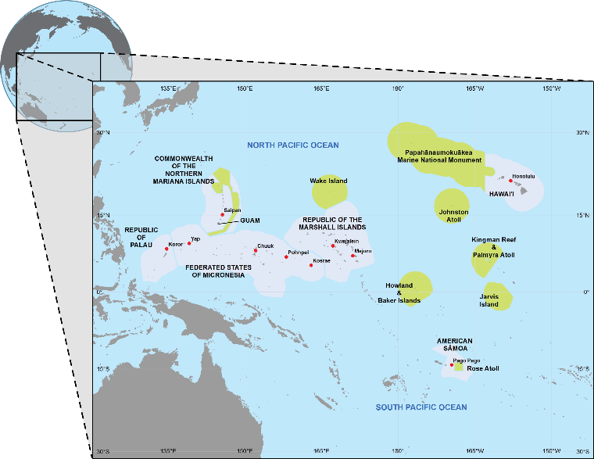
Fig. 27.1: Pacific Islands Region Map
Ch. 27 | Hawai‘i and U.S.-Affiliated Pacific Islands
The U.S. Pacific Islands region includes the state of Hawaiʻi, as well as the U.S.-Affiliated Pacific Islands (USAPI): the Territories of Guam and American Sāmoa (AS), the Commonwealth of the Northern Mariana Islands (CNMI), the Republic of Palau (RP), the Federated States of Micronesia (FSM), and the Republic of the Marshall Islands (RMI). While citizens of Guam and the CNMI are U.S. citizens, those from AS are U.S. nationals. Under the Compact of Free Association (COFA), citizens from FSM, RP, and RMI can live and work in the United States without visas, and the U.S. armed forces are permitted to operate in COFA areas. On this map, shaded areas indicate the exclusive economic zone of each island, including regional marine national monuments (in green). Source: adapted from Keener et al. 2012.²³
Notes:
23: Keener, V., J.J. Marra, M.L. Finucane, D. Spooner, and M.H. Smith, Eds., 2012: Climate Change and Pacific Islands: Indicators and Impacts. Report for the 2012 Pacific Islands Regional Climate Assessment (PIRCA). Island Press, Washington, DC, 170 pp. http://www.pacificrisa.org/projects/pirca/

Slide 9
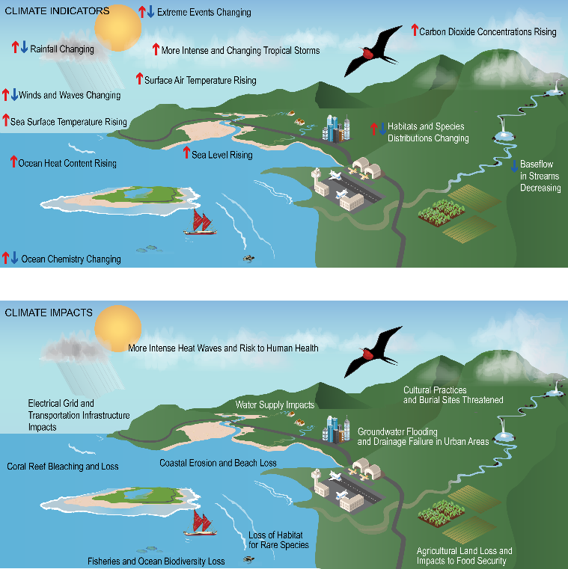
Fig. 27.2: Climate Indicators and Impacts
Ch. 27 | Hawai‘i and U.S.-Affiliated Pacific Islands
Monitoring regional indicator variables in the atmosphere, land, and ocean allows for tracking climate variability and change. (top) Observed changes in key climate indicators such as carbon dioxide concentration, sea surface temperatures, and species distributions in the Hawai‘i and U.S.-Affiliated Pacific Islands region result in (bottom) impacts to multiple sectors and communities, including built infrastructure, natural ecosystems, and human health. Connecting changes in climate indicators to how impacts are experienced is crucial in understanding and adapting to risks across different sectors. Source: adapted from Keener et al. 2012.²³
Notes:
23: Keener, V., J.J. Marra, M.L. Finucane, D. Spooner, and M.H. Smith, Eds., 2012: Climate Change and Pacific Islands: Indicators and Impacts. Report for the 2012 Pacific Islands Regional Climate Assessment (PIRCA). Island Press, Washington, DC, 170 pp. http://www.pacificrisa.org/projects/pirca/

Slide 10
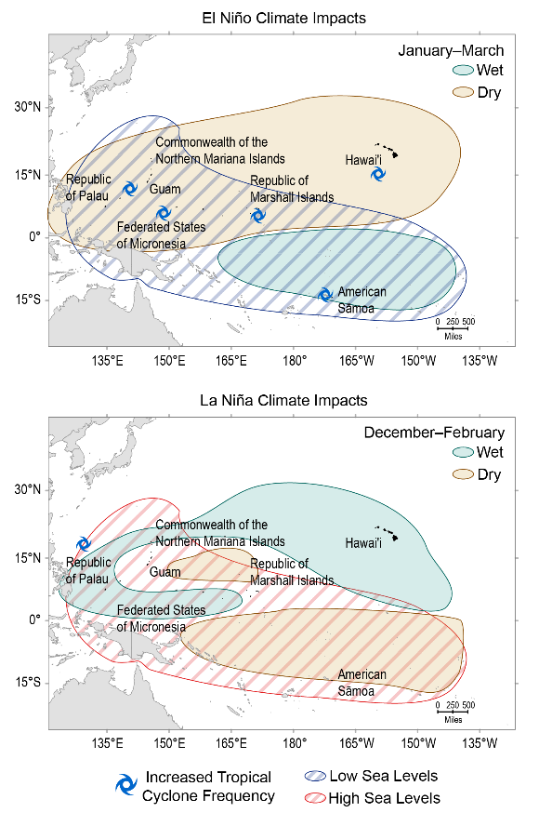
Fig. 27.3: Seasonal Effects of El Niño and La Niña in the Pacific Islands Region
Ch. 27 | Hawai‘i and U.S.-Affiliated Pacific Islands
A prevalent cause of year-to-year changes in climate patterns in the U.S. Pacific Islands region is the El Niño–Southern Oscillation (ENSO) phenomenon. These maps show how (top) El Niño and (bottom) La Niña most commonly affect precipitation, sea level, and storm frequency in the Pacific Islands region in the year after an ENSO event. During certain months in the boreal (northern) winter, El Niño and La Niña commonly produce patterns that are different from those following an ENSO neutral year. After an El Niño, islands in the central Pacific (such as Hawai‘i) and islands in the western Pacific (such as the Republic of Palau and Guam) experience drier than normal conditions from January to March, while the western and southern Pacific see abnormally low sea levels. After a La Niña, the patterns are reversed and occur earlier (December through February).⁵⁰ Source: East-West Center.
Notes:
50: Sutton, J., N. Luchetti, E. Wright, M.C. Kruk, and J.J. Marra, 2015: An El Niño Southern Oscillation (ENSO) Based Precipitation Climatology For the United States Affiliated Pacific Islands (USAPI) Using the PERSIANN Climate Data Record (CDR). NOAA National Centers for Environmental Information, Asheville, NC, 478 pp. ftp://ftp.ncdc.noaa.gov/pub/data/coastal/ENSO_Rainfall_Atlas.pdf

Slide 11
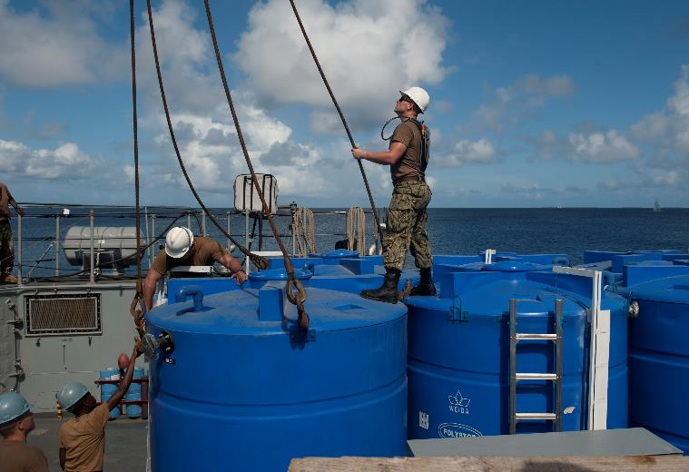
Fig. 27.4: Emergency Drought Action for Islands Residents
Ch. 27 | Hawai‘i and U.S.-Affiliated Pacific Islands
U.S. Navy sailors unload reverse osmosis water supply systems in the Republic of the Marshall Islands in 2013 to provide relief from severe drought. The systems will produce potable water for more than 15,000 Ebeye Island residents. Photo credit: Mass Communication Specialist 2nd Class Tim D. Godbee, U.S. Navy.

Slide 12
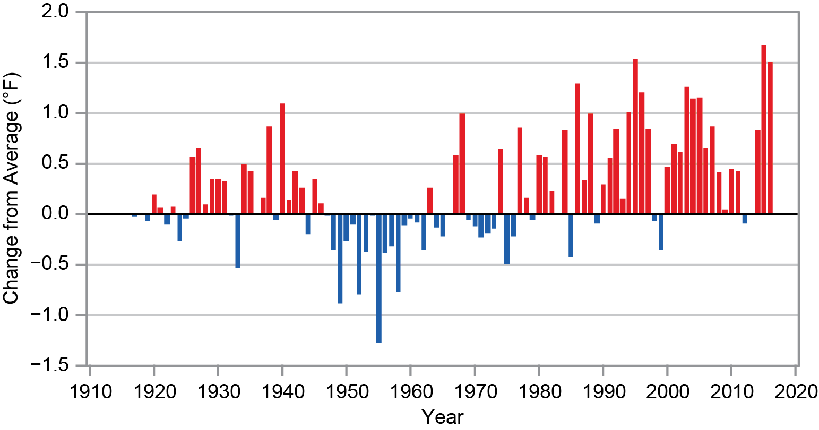
Fig. 27.5: Hawai’i Annual Average Temperature Changes
Ch. 27 | Hawai‘i and U.S.-Affiliated Pacific Islands
In Hawai‘i, annual average temperatures over the past century show a statistically significant warming trend, although both warming and cooling periods occurred. Based on a representative network of weather stations throughout the islands, this figure shows the difference in annual average temperature as compared to the average during 1944­–1980 (this period was selected as the baseline because it has the greatest number of index stations available), with red bars showing years with above average temperatures and blue bars showing years with below average temperatures. As temperature continues to rise across the region and cloud cover decreases in some areas, evaporation is expected to increase, causing both reduced water supply and higher water demand. Source: University of Hawai‘i at Mānoa, Department of Geography and Environment.

Slide 13
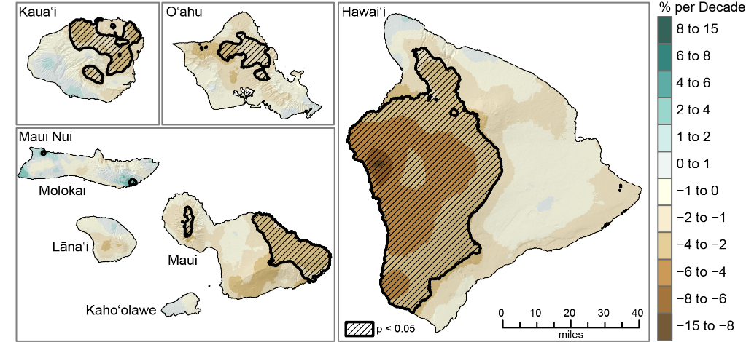
Fig. 27.6: Hawai’i Rainfall Trends
Ch. 27 | Hawai‘i and U.S.-Affiliated Pacific Islands
The figure shows the changes in annual rainfall (percent per decade) from 1920 to 2012 for the State of Hawai‘i. Statistically significant trends are indicated with black hatching. Almost the entire state has seen rainfall decreases since 1920. The sharpest downward trends are found on the western part of Hawai‘i Island. On other islands, significant decreases have occurred in the wetter areas. Source: adapted from Frazier & Giambelluca 2017.⁶⁰ ©Royal Meteorological Society.
Notes:
60: Frazier, A.G. and T.W. Giambelluca, 2017: Spatial trend analysis of Hawaiian rainfall from 1920 to 2012. International Journal of Climatology, 37 (5), 2522-2531. http://dx.doi.org/10.1002/joc.4862

Slide 14
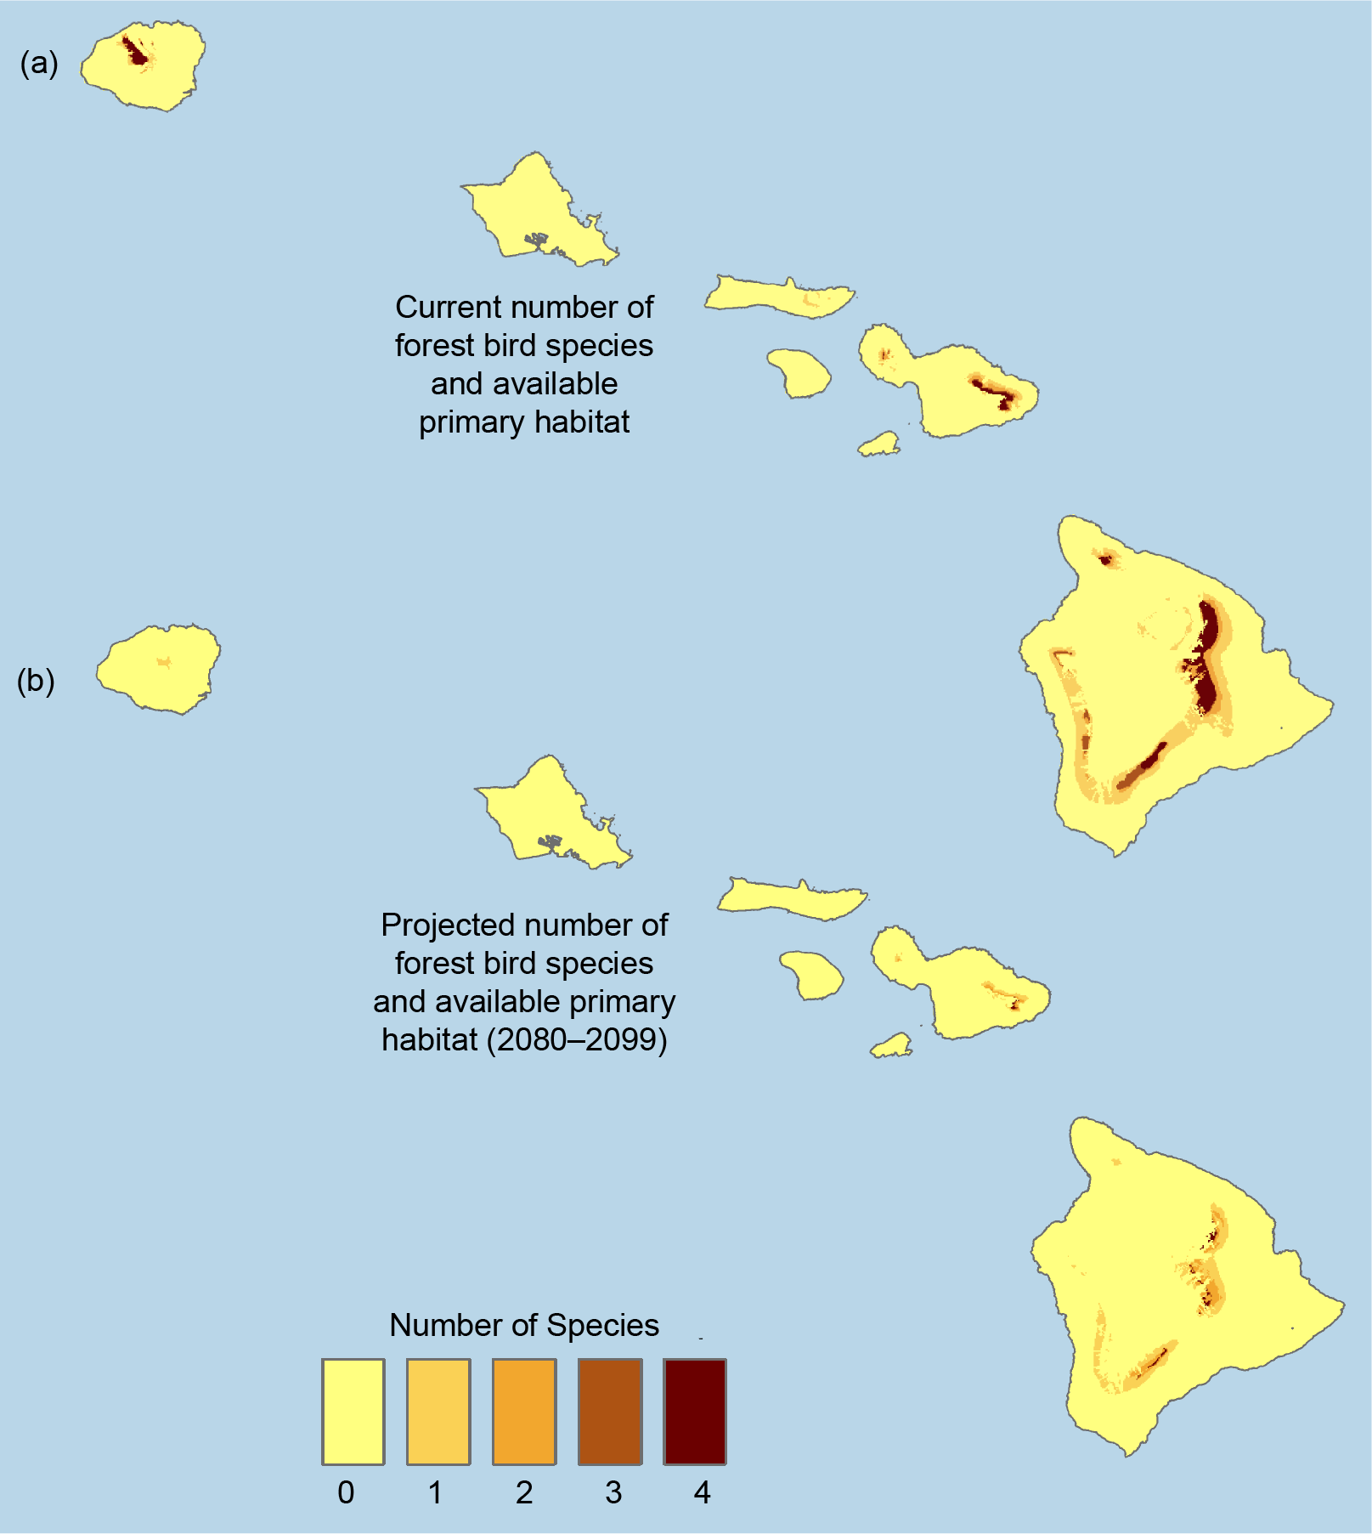
Fig. 27.7: Hawaiian Forest Bird Species
Ch. 27 | Hawai‘i and U.S.-Affiliated Pacific Islands
The figure shows the number of native Hawaiian forest bird species based on model results for (a) current and (b) future climate conditions. The future conditions are for the year 2100 using the middle-of-the-road scenario (SRES A1B). These projections include 10 species that represent the most rare and endangered native forest birds in Hawaiʻi. The number of these species and their available habitat are projected to be drastically reduced by 2100. Sources: adapted from Fortini et al. 2015⁴³ (CC BY 4.0).
Notes:
43: Fortini, L.B., A.E. Vorsino, F.A. Amidon, E.H. Paxton, and J.D. Jacobi, 2015: Large-scale range collapse of Hawaiian forest birds under climate change and the need 21st century conservation options. PLOS ONE, 10, e0144311. http://dx.doi.org/10.1371/journal.pone.0140389

Slide 15
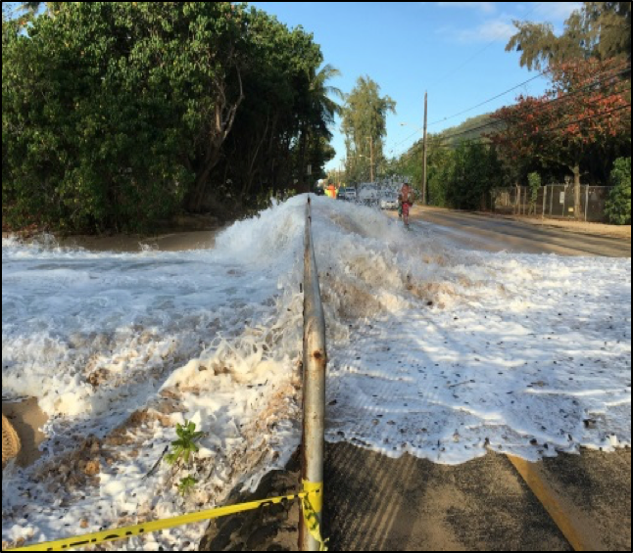
Fig. 27.8: Roadways Flood Periodically on O’ahu
Ch. 27 | Hawai‘i and U.S.-Affiliated Pacific Islands
The photo shows North Shore, Oʻahu, in the winter of 2016. Episodic flooding in the Pacific Islands will increase as sea level rises. Photo credit: Steven Businger.

Slide 16
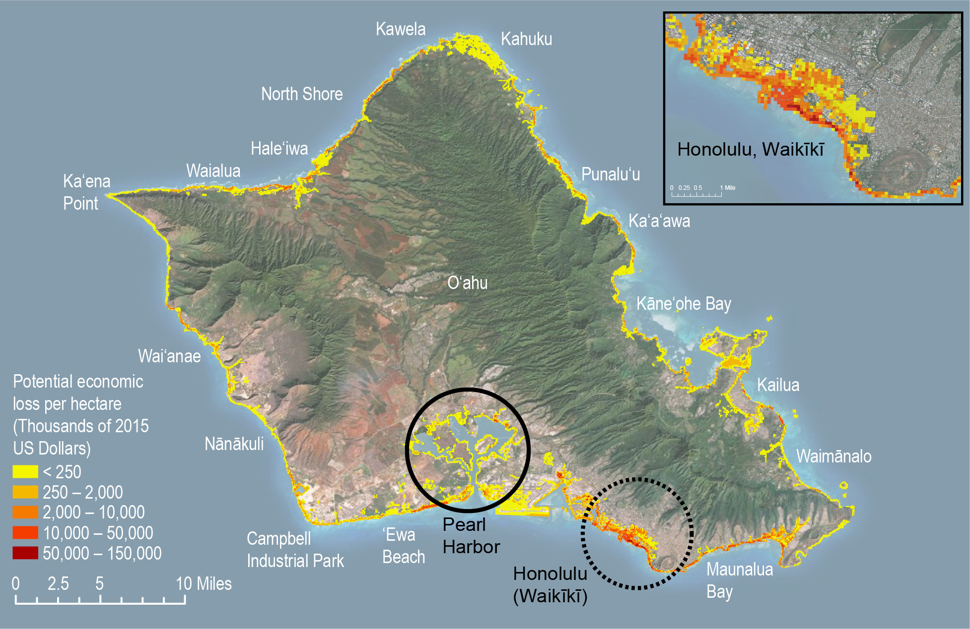
Fig. 27.9: Potential Economic Loss from Sea Level Rise, O’ahu, Hawai’i
Ch. 27 | Hawai‘i and U.S.-Affiliated Pacific Islands
This map highlights potential economic losses (in 2015 dollars) in the exposure area associated with 3.2 feet of sea level rise on the island of O‘ahu, Hawai‘i. Potential economic losses are estimated from impacts to land and residential and commercial infrastructure. Highly impacted areas at risk of large economic losses include the U.S. Pacific Command and military infrastructure concentrated in Pearl Harbor (black circle) and the vulnerable tourist areas surrounding Waikīkī (dashed black circle). Source: adapted by Tetra Tech Inc. from the Hawai‘i Climate Change Mitigation and Adaptation Commission 2017.⁴²
Notes:
42: Hawai‘i Climate Commision, 2017: Hawaiʻi Sea Level Rise Vulnerability and Adaptation Report. Hawai‘i Climate Change Mitigation and Adaptation Commission, Honolulu, HI, 264 pp. https://climateadaptation.hawaii.gov/wp-content/uploads/2017/12/SLR-Report_Dec2017.pdf

Slide 17
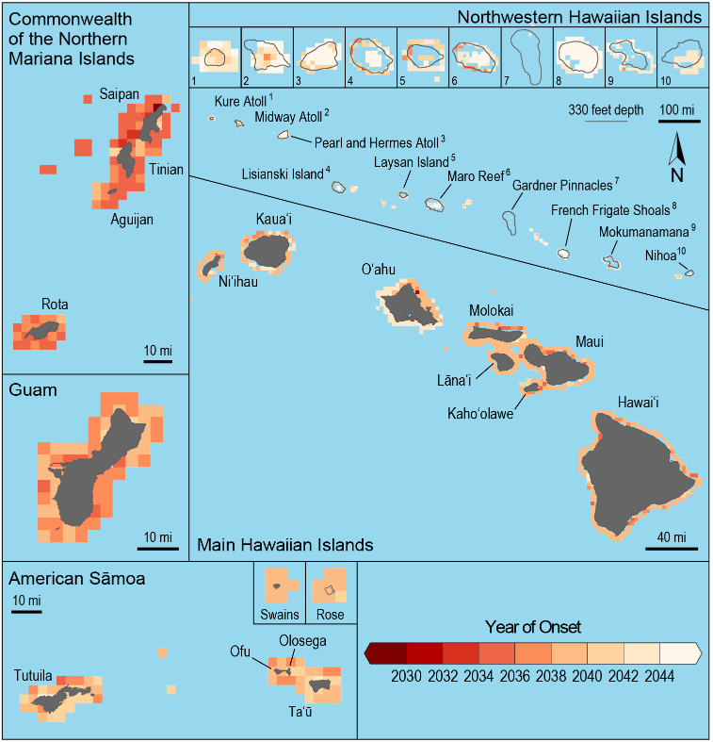
Fig. 27.10: Projected Onset of Annual Severe Coral Reef Bleaching
Ch. 27 | Hawai‘i and U.S.-Affiliated Pacific Islands
The figure shows the years when severe coral reef bleaching is projected to occur annually for the islands and atolls in the region under a higher scenario (RCP8.5). Darker colors indicate earlier projected onset of coral bleaching. Under projected warming of approximately 0.5°F per decade, all nearshore coral reefs in Hawai‘i and the U.S.-Affiliated Pacific Islands will experience annual bleaching before 2050. Source: NOAA.

Slide 18
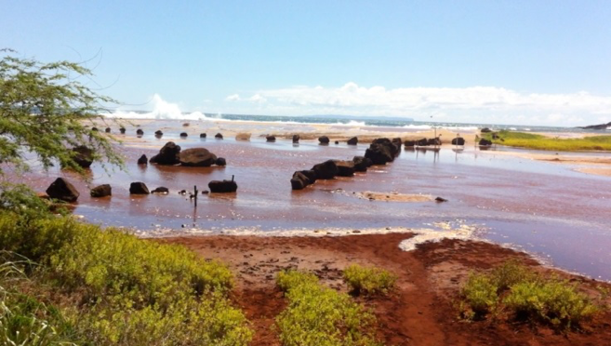
Fig. 27.11: Salt Cultivation on Kaua‘i
Ch. 27 | Hawai‘i and U.S.-Affiliated Pacific Islands
Flooding on the island of Kauaʻi, Hawaiʻi, impacts the cultural practice of paʻakai (salt) cultivation. Photo credit: Malia Nobrega-Olivera.

Slide 19
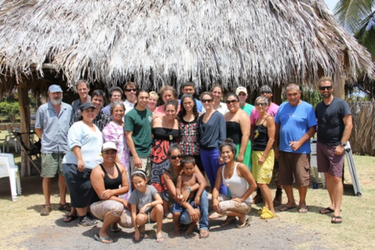
Fig. 27.12: Preparing Molokai’s Fishponds for Climate Change
Ch. 27 | Hawai‘i and U.S.-Affiliated Pacific Islands
Ka Honua Momona hosted Molokai’s loko iʻa managers, Hawaiʻi’s climate scientists, and other resource managers in April 2015. Photo credit: Hauʻoli Waiau.

Slide 20
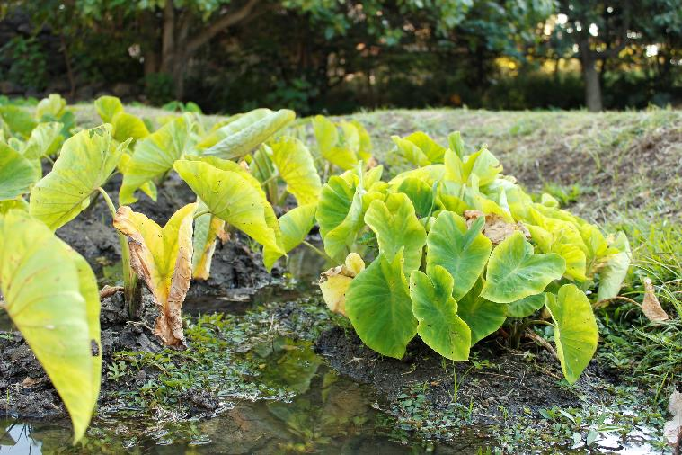
Fig. 27.13: Crop Trials of Salt-Tolerant Taro Varieties
Ch. 27 | Hawai‘i and U.S.-Affiliated Pacific Islands
Taro trials are underway in Palau, with results so far indicating that three varieties have tolerance to saltwater. Photo credit: Malia Nobrega-Olivera.

Slide 21
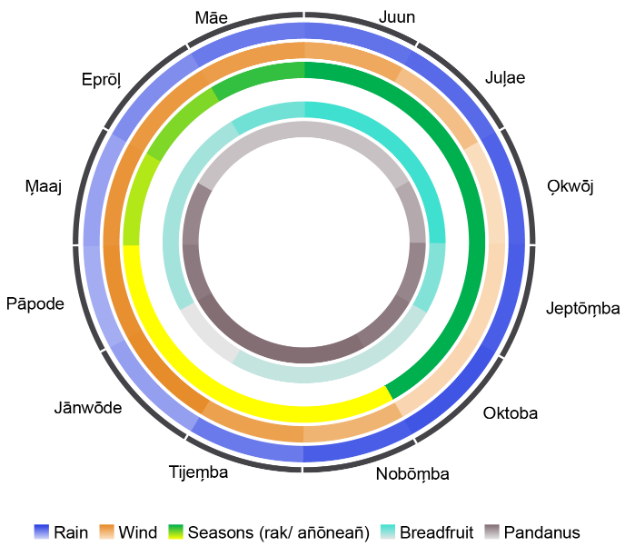
Fig. 27.14: Marshallese Traditional Agroforestry Calendar
Ch. 27 | Hawai‘i and U.S.-Affiliated Pacific Islands
The Marshallese Traditional Agroforestry Calendar combines climate data and traditional season designations and knowledge about the harvest times of perennial crops throughout the year. Months are displayed in Marshallese on the outer ring, while inner rings show how wind and rain patterns and the harvest of two crops typically change throughout the year. The color gradients show the intensity of the harvest or the climate variable, with more intense colors representing larger amounts harvested or higher amounts of rain, for example, at various times. A web-based tool offers two versions, depending on the status of ENSO conditions. Source: adapted by Victor Garcia, Jr., from Friday et al. 2017.¹⁸⁸
Notes:
188: Friday, K., V. Garcia, Jr., M. Haws, H. Manner, J. Marra, J.T. Potemra, and L. Rufus, 2017: Agroforestry in the Climate of the Marshall Islands, last modified 2017. http://oos.soest.hawaii.edu/pacific-rcc/Marshalls%20Agroforestry/site/

Slide 22
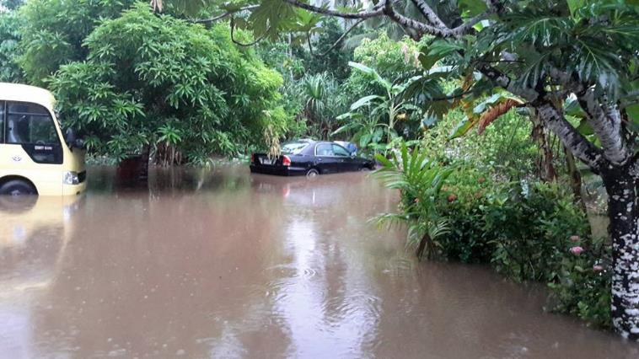
Fig. 27.15: Flooding in Kosrae
Ch. 27 | Hawai‘i and U.S.-Affiliated Pacific Islands
A combination of heavy rain, exceptionally high tides, and waves caused flooding in Kosrae, the Federated States of Micronesia, in February 2017. Photo credit: Delia Sigrah.

Slide 23
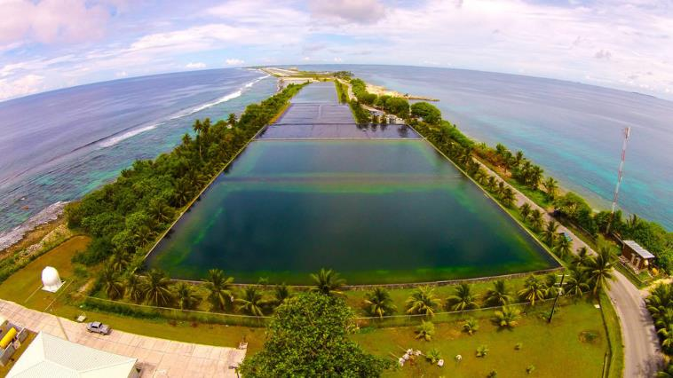
Fig. 27.16: Reservoirs in the Marshall Islands
Ch. 27 | Hawai‘i and U.S.-Affiliated Pacific Islands
A series of reservoirs that provide the main water supply on Majuro Atoll in the Republic of the Marshall Islands are filled with runoff from the Majuro airport runway. The water supply is vulnerable to drought and saltwater overwash from both the lagoon and ocean (pictured). Photo credit: Majuro Water and Sewer Company.

Slide 24
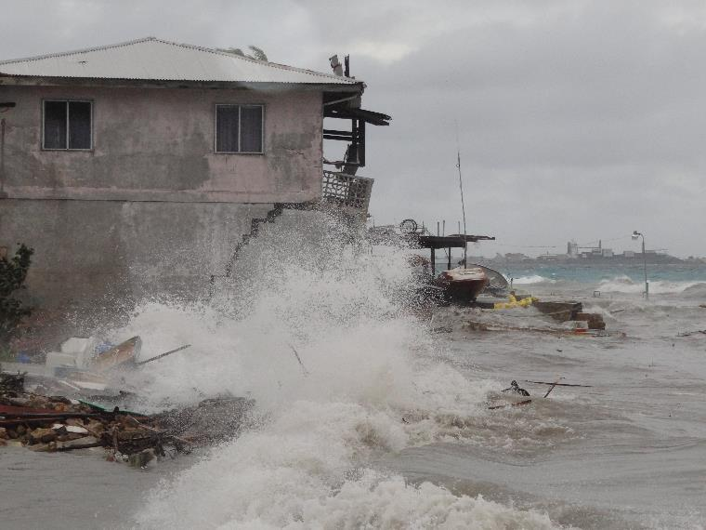
Fig. 27.17: A Marshall Islands Storm
Ch. 27 | Hawai‘i and U.S.-Affiliated Pacific Islands
An unseasonable storm hit the Marshall Islands on July 3rd, 2015. Storms this strong historically have been rare in the Marshall Islands, but the frequency of the most intense of these storms is projected to increase in the western North Pacific in the future. Photo credit: Marshall Islands Journal.

Slide 25
Ch. 27 | Hawai‘i and U.S.-Affiliated Pacific Islands
27
Chapter Author Team
Federal Coordinating Lead Author
David Helweg, DOI Pacific Islands Climate Adaptation Science Center
Chapter Lead
Victoria Keener, East-West Center
Chapter Authors
Susan Asam, ICF
Seema Balwani, National Oceanic and Atmospheric Administration
Maxine Burkett, University of Hawai’i at Mānoa
Charles Fletcher, University of Hawai’i at Mānoa
Thomas Giambelluca, University of Hawai’i at Mānoa
Zena Grecni, East-West Center
Malia Nobrega-Olivera, University of Hawai’i at Mānoa
Jeffrey Polovina, NOAA Pacific Islands Fisheries Science Center
Gordon Tribble, USGS Pacific Island Ecosystems Research Center
Review Editor
Jo-Ann Leong, Hawai’i Institute of Marine Biology

Slide 26
Ch. 27 | Hawai‘i and U.S.-Affiliated Pacific Islands
27
Acknowledgments
Technical Contributors
Malia Akutagawa, University of Hawaiʻi at Mānoa, Hawaiʻinuiākea School of Hawaiian Knowledge, Kamakakūokalani Center for Hawaiian Studies, William S. Richardson School of Law, Ka Huli Ao Center for Excellence in Native Hawaiian Law
Rosie Alegado, University of Hawaiʻi at Mānoa, Oceanography, UH Sea Grant
Tiffany Anderson, University of Hawai‘i at Mānoa, Geology and Geophysics
Patrick Barnard, U.S. Geological Survey–Santa Cruz
Rusty Brainard, NOAA Pacific Islands Fisheries Science Center
Laura Brewington, East-West Center, Pacific RISA
Jeff Burgett, Pacific Islands Climate Change Cooperative
Rashed Chowdhury, NOAA Pacific ENSO Applications Climate Center
Makena Coffman, University of Hawai‘i at Mānoa, Urban and Regional Planning
Chris Conger, Sea Engineering, Inc.
Kitty Courtney, Tetra Tech, Inc.
Stanton Enomoto, Pacific Islands Climate Change Cooperative
Patricia Fifita, University of Hawai‘i, Pacific Islands Climate Change Cooperative
Lucas Fortini, USGS Pacific Island Ecosystems Research Center

Slide 27
Ch. 27 | Hawai‘i and U.S.-Affiliated Pacific Islands
27
Acknowledgments
Technical Contributors (cont.)
Abby Frazier, USDA Forest Service
Kathleen Stearns Friday, USDA Forest Service, Institute of Pacific Islands Forestry
Neal Fujii, State of Hawai‘i Commission on Water Resource Management
Ruth Gates, University of Hawai‘i at Mānoa, School of Ocean and Earth Science and Technology
Christian Giardina, U.S. Forest Service, Institute of Pacific Islands Forestry
Scott Glenn, State of Hawai‘i Department of Health, Office of Environmental Quality Control
Matt Gonser, University of Hawai‘i Sea Grant
Jamie Gove, NOAA Pacific Islands Fisheries Science Center
Robbie Greene, CNMI Bureau of Environmental and Coastal Quality
Shellie Habel, University of Hawai‘i at Mānoa, School of Ocean and Earth Science and Technology
Justin Hospital, NOAA Pacific Islands Fisheries Science Center
Darcy Hu, National Park Service
Jim Jacobi, U.S. Geological Survey
Krista Jaspers, East-West Center, Pacific RISA
Todd Jones, NOAA Pacific Islands Fisheries Science Center
Charles Kaaiai, Western Pacific Regional Fishery Management Council

Slide 28
Ch. 27 | Hawai‘i and U.S.-Affiliated Pacific Islands
27
Acknowledgments
Technical Contributors (cont.)
Lauren Kapono, NOAA Papahānaumokuākea Marine National Monument
Hiʻilei Kawelo, Paepae O Heʻeia
Benton Kealii Pang, U.S. Fish and Wildlife Service
Karl Kim, University of Hawai‘i, National Disaster Preparedness Training Center
Jeremy Kimura, State of Hawai‘i Commission on Water Resource Management
Romina King, University of Guam and Pacific Islands Climate Adaptation Science Center
Randy Kosaki, National Oceanic and Atmospheric Administration
Michael Kruk, ERT, Inc.
Mark Lander, University of Guam, Water and Environmental Research Institute
Leah Laramee, State of Hawaiʻi Department of Land and Natural Resources
Noelani Lee, Ka Honua Momona
Sam Lemmo, State of Hawai‘i Department of Land and Natural Resources, Interagency Climate Adaptation Committee
Rhonda Loh, Hawaiʻi Volcanoes National Park
Richard MacKenzie, USDA Forest Service, Institute of Pacific Islands Forestry
John Marra, National Oceanic and Atmospheric Administration
Xavier Matsutaro, Republic of Palau, Office of Climate Change
Marie McKenzie, Pacific Islands Climate Change Cooperative

Slide 29
Ch. 27 | Hawai‘i and U.S.-Affiliated Pacific Islands
27
Acknowledgments
Technical Contributors (cont.)
Mark Merrifield, University of Hawai‘i at Mānoa
Wendy Miles, Pacific Islands Climate Change Cooperative
Lenore Ohye, State of Hawai‘i Commission on Water Resource Management
Kirsten Oleson, University of Hawai‘i at Mānoa
Tom Oliver, University of Hawaiʻi at Mānoa, Joint Institute for Marine and Atmospheric Research
Tara Owens, University of Hawai‘i Sea Grant
Jessica Podoski, U.S. Army Corps of Engineers—Fort Shafter
Dan Polhemus, U.S. Fish and Wildlife Service
Kalani Quiocho, NOAA Papahānaumokuākea Marine National Monument
Robert Richmond, University of Hawaiʻi, Kewalo Marine Lab
Joby Rohrer, O‘ahu Army Natural Resources
Fatima Sauafea-Le‘au, National Oceanic and Atmospheric Administration—American Sāmoa
Afsheen Siddiqi, State of Hawaiʻi Department of Land and Natural Resources
Irene Sprecher, State of Hawaiʻi, Department of Land and Natural Resources
Joshua Stanbro, Hawai‘i Community Foundation
Mark Stege, The Nature Conservancy—Majuro

Slide 30
Ch. 27 | Hawai‘i and U.S.-Affiliated Pacific Islands
27
Acknowledgments
Technical Contributors (cont.)
Curt Storlazzi, U.S. Geological Survey–Santa Cruz
William V. Sweet, National Oceanic and Atmospheric Administration
Kelley Tagarino, University of Hawai‘i Sea Grant
Jean Tanimoto, National Oceanic and Atmospheric Administration
Bill Thomas, NOAA Office for Coastal Management
Phil Thompson, University of Hawai‘i at Mānoa, Oceanography
Mililani Trask, Indigenous Consultants, LLC
Barry Usagawa, Honolulu Board of Water Supply
Kees van der Geest, United Nations University, Institute for Environment and Human Security
Adam Vorsino, U.S. Fish and Wildlife Service
Richard Wallsgrove, Blue Planet Foundation
Matt Widlansky, University of Hawai‘i, Sea Level Center
Phoebe Woodworth-Jefcoats, NOAA Pacific Islands Fisheries Science Center
Stephanie Yelenik, USGS Pacific Island Ecosystems Research Center
USGCRP Coordinators
Allyza Lustig, Program Coordinator
Fredric Lipschultz, Senior Scientist and Regional Coordinator

Slide 31
Keener, V., D. Helweg, S. Asam, S. Balwani, M. Burkett, C. Fletcher, T. Giambelluca, Z. Grecni, M. Nobrega-Olivera, J. Polovina, and G. Tribble, 2018: Hawai‘i and U.S.-Affiliated Pacific Islands. In Impacts, Risks, and Adaptation in the United States: Fourth National Climate Assessment, Volume II [Reidmiller, D.R., C.W. Avery, D.R. Easterling, K.E. Kunkel, K.L.M. Lewis, T.K. Maycock, and B.C. Stewart (eds.)]. U.S. Global Change Research Program, Washington, DC, USA. doi: 10.7930/NCA4.2018.CH27
https://nca2018.globalchange.gov/chapter/hawaii-pacific

