Slide 1
Chapter 6 | Forests

Slide 2
Ch. 6 | Forests
6
Key Message #1
Ecological Disturbances and Forest Health
It is very likely that more frequent extreme weather events will increase the frequency and magnitude of severe ecological disturbances, driving rapid (months to years) and often persistent changes in forest structure and function across large landscapes. It is also likely that other changes, resulting from gradual climate change and less severe disturbances, will alter forest productivity and health and the distribution and abundance of species at longer timescales (decades to centuries).

Slide 3
Ch. 6 | Forests
6
Key Message #2
Ecosystem Services
It is very likely that climate change will decrease the ability of many forest ecosystems to provide important ecosystem services to society. Tree growth and carbon storage are expected to decrease in most locations as a result of higher temperatures, more frequent drought, and increased disturbances. The onset and magnitude of climate change effects on water resources in forest ecosystems will vary but are already occurring in some regions.

Slide 4
Ch. 6 | Forests
6
Key Message #3
Adaptation
Forest management activities that increase the resilience of U.S. forests to climate change are being implemented, with a broad range of adaptation options for different resources, including applications in planning. The future pace of adaptation will depend on how effectively social, organizational, and economic conditions support implementation.

Slide 5
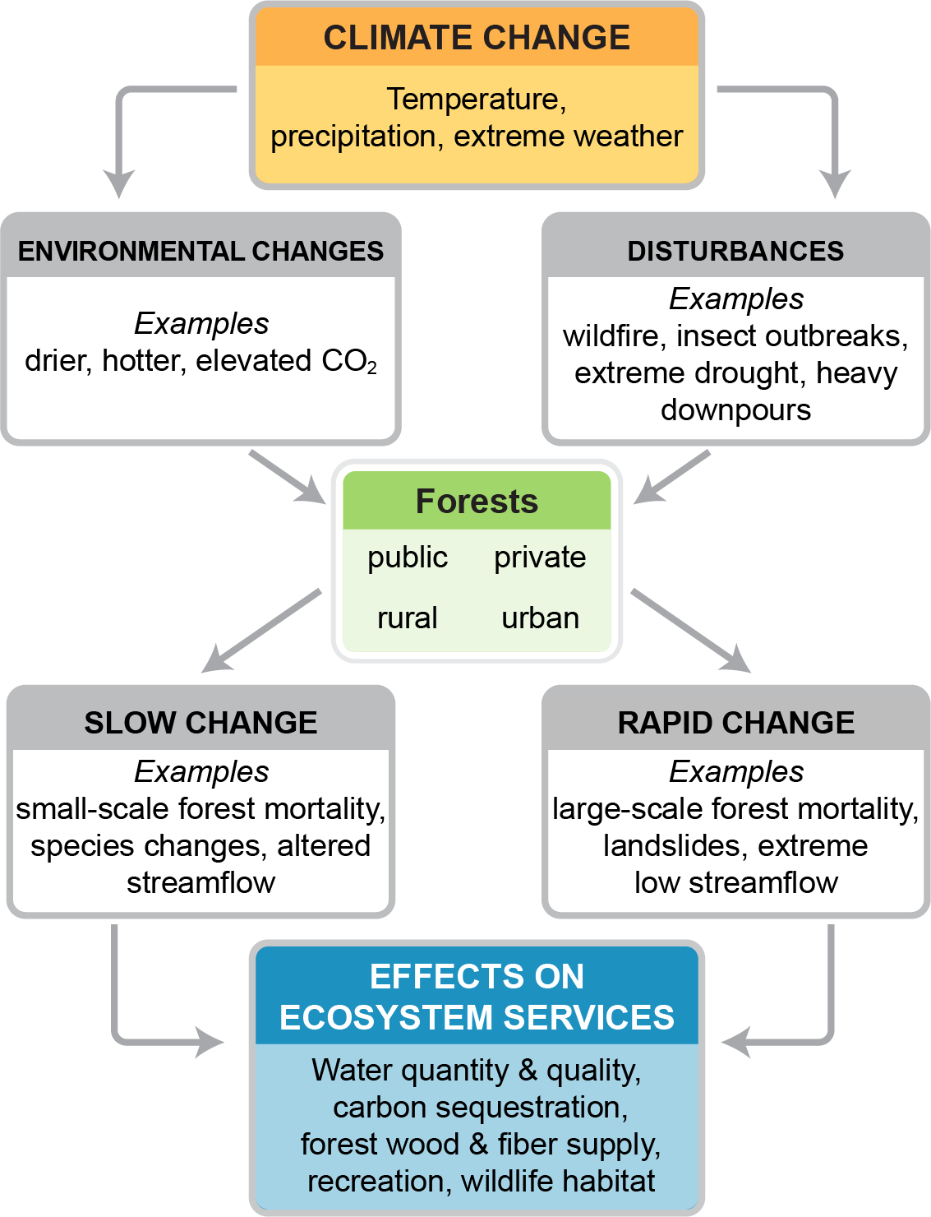
Fig. 6.1: Climate Change Effects on Ecosystem Services
Ch. 6 | Forests
Many factors in the biophysical environment interact with climate change to influence forest productivity, structure, and function, ultimately affecting the ecosystem services that forests provide to people in the United States and globally. Source: U.S. Forest Service.

Slide 6
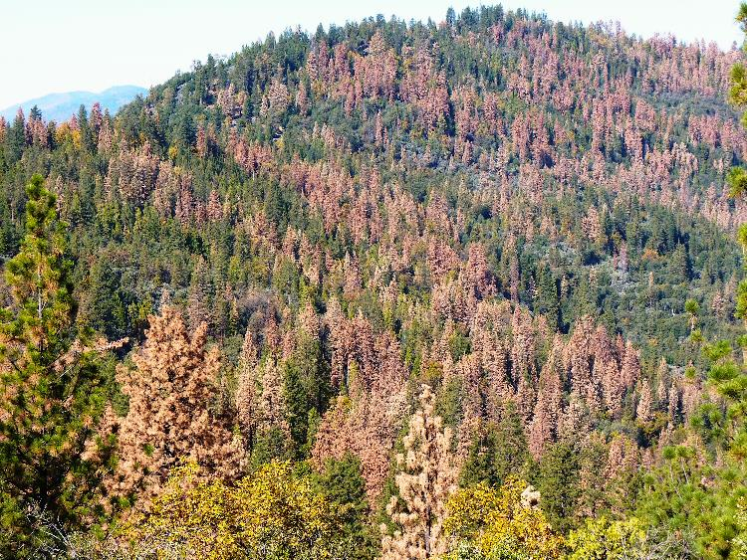
Fig. 6.2: Tree Mortality at Bass Lake Recreation Area
Ch. 6 | Forests
A five-year drought in California (2011–2016) led to western pine beetle outbreaks, which contributed to the mortality of 129 million trees. As a result, the structure and function of these forests are changing rapidly. Prolonged droughts are expected to become more common as the climate continues to warm, increasing stress on lower-elevation tree species. Photo credit: Marc Meyer, U.S. Forest Service.

Slide 7
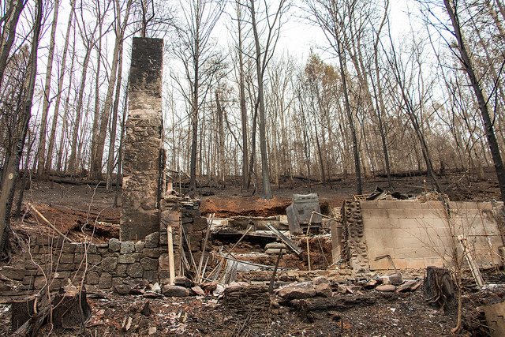
Fig. 6.3: Fire Damage in Gatlinburg, Tennessee
Ch. 6 | Forests
In autumn 2016, a prolonged dry period and arson in the southern Appalachian region resulted in 50 major wildfires that burned over 100,000 acres in 8 states, caused 15 deaths, and damaged or destroyed nearly 2,500 structures in Gatlinburg, Tennessee. If drought or prolonged dry periods increase in this region as expected, fire risk will increase in both forests and local communities. Photo credit: Flickr user highlander411 (CC BY 2.0).

Slide 8
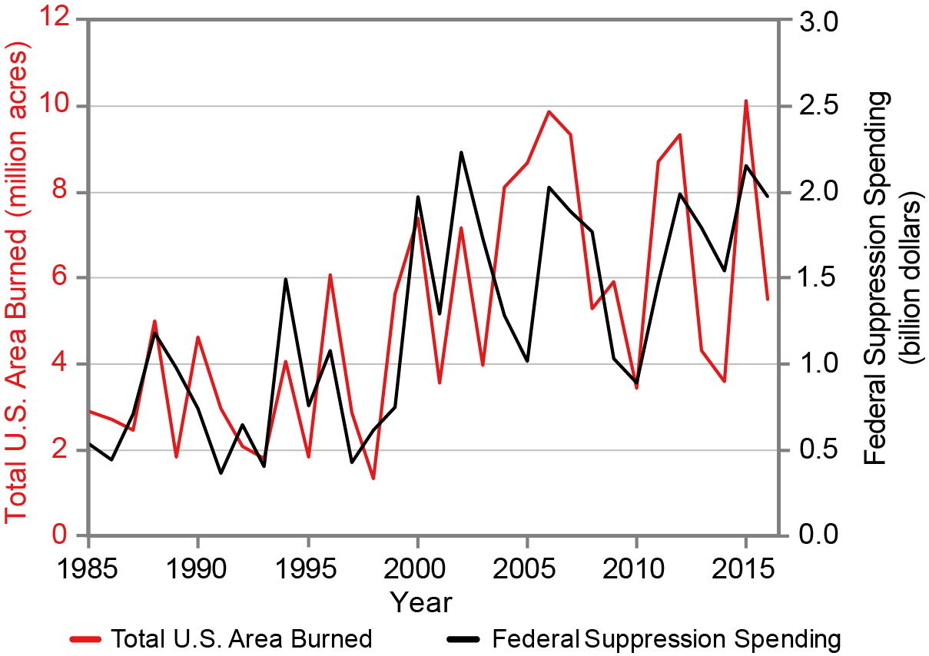
Fig. 6.4: Wildfires—
Changes in Area Burned and Cost
Ch. 6 | Forests
This figure shows the annual wildfire area burned in the United States (red) and the annual federal wildfire suppression expenditures (black), scaled to constant 2016 U.S. dollars (Consumer Price Index deflated). Trends for both area burned and wildfire suppression costs indicate about a fourfold increase over a 30-year period. Source: U.S. Forest Service

Slide 9
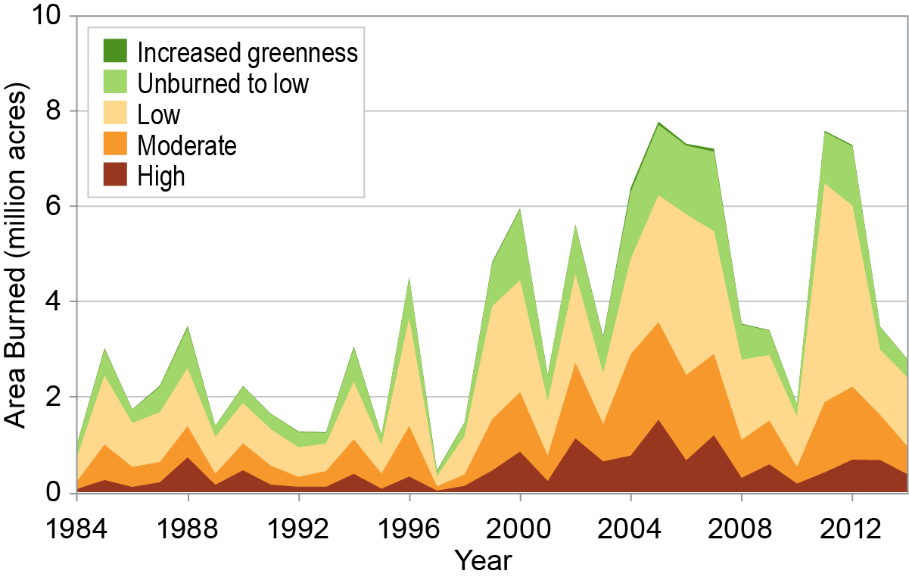
Fig. 6.5: Area Burned by Large Wildfires
Ch. 6 | Forests
This figure illustrates the area burned by large wildfires (greater than 1,000 acres in the western United States and greater than 500 acres in the eastern United States) for 1984–2014. Although the area with moderate-to-high burn severity (amount of fire damage to the forest canopy) has increased in recent decades, it has not changed as a proportion of the total area burned (severity does vary across regions). Increases in the areas of severely burned forests will have implications for ecosystem processes, such as tree regeneration^{57,58,59} and ecosystem services, including timber production, water quality, and recreation. Source: redrawn from EPA 2016.⁶⁰
Notes:
57: Savage, M. and J.N. Mast, 2005: How resilient are southwestern ponderosa pine forests after crown fires? Canadian Journal of Forest Research, 35 (4), 967- 977. http://dx.doi.org/10.1139/x05-028
58: Keane, R.E. and C. Key, 2007: CCE fire regimes and their management. Sustaining Rocky Mountain Landscapes: Science, Policy and Management for the Crown of the Continent Ecosystem. Prato, T. and D. Fagre, Eds. Resources for the Future, Washington, DC, 201-212. http://pubs.er.usgs.gov/publication/70160295
59: Hessburg, P.F., R.B. Salter, and K.M. James, 2007: Re- examining fire severity relations in pre-management era mixed conifer forests: Inferences from landscape patterns of forest structure. Landscape Ecology, 22 (1), 5-24. http://dx.doi.org/10.1007/s10980-007-9098-2
60: EPA, 2016: Climate Change Indicators: Wildfires. U.S. Environmental Protection Agency (EPA), Washington, DC. https://www.epa.gov/climate-indicators/climate-change-indicators-wildfires

Slide 10
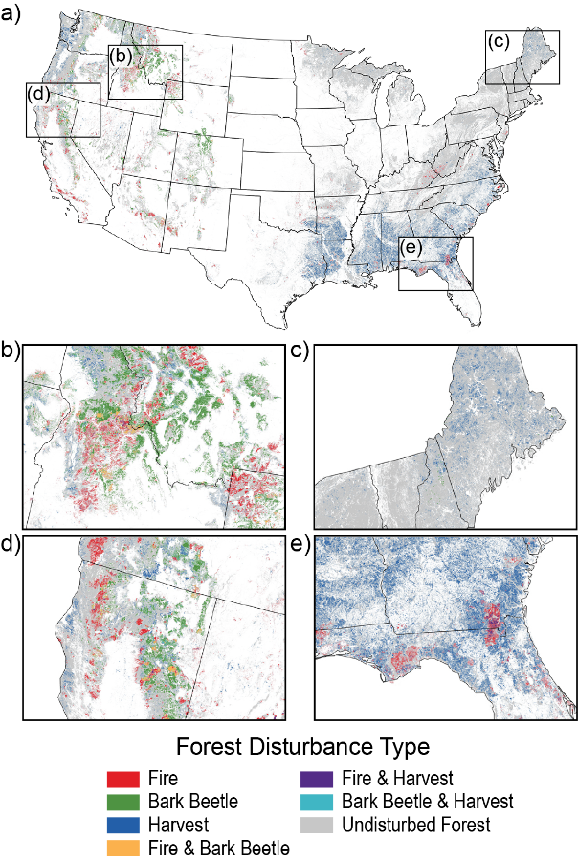
Fig. 6.6: Forest Disturbances Across the United States
Ch. 6 | Forests
This figure shows the cumulative area of disturbed forestland across the contiguous United States for 1984–2014. The small boxes illustrate how disturbances differ regionally. Data for Alaska, Hawai‘i and the U.S.-Affiliated Pacific Islands, and the U.S. Caribbean regions were not shown on the original map from the published source. Source: adapted from Williams et al. 2016.¹¹⁴
Notes:
114: Williams, C.A., H. Gu, R. MacLean, J.G. Masek, and G.J. Collatz, 2016: Disturbance and the carbon balance of US forests: A quantitative review of impacts from harvests, fires, insects, and droughts. Global and Planetary Change, 143, 66-80. http://dx.doi.org/10.1016/j.gloplacha.2016.06.002

Slide 11
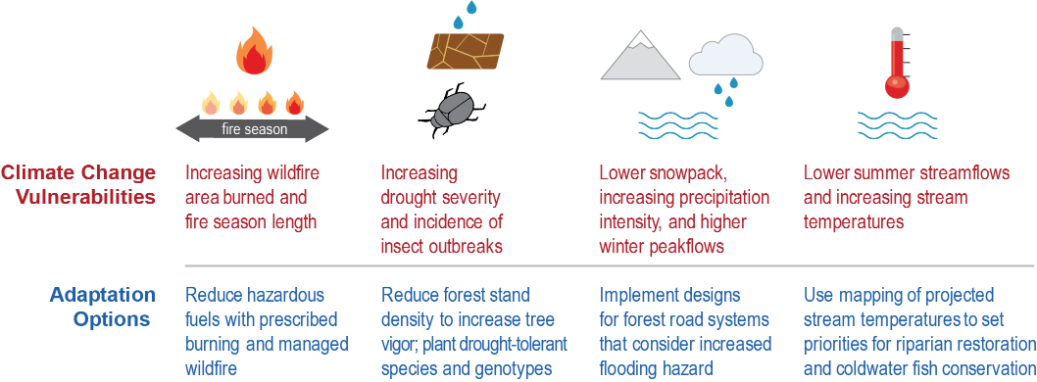
Fig. 6.7: Climate Change Vulnerabilities and Adaptation Options
Ch. 6 | Forests
To increase resilience to future stressors and disturbances, examples of adaptation options (risk management) have been developed in response to climate change vulnerabilities in forest ecosystems (risk assessment) in the Pacific Northwest. Vulnerabilities and adaptation options vary among different forest ecosystems. Sources: U.S. Forest Service and University of Washington.

Slide 12
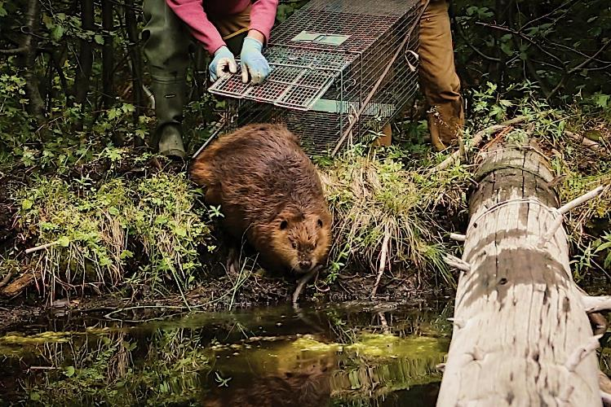
Fig. 6.8: Reintroducing Beavers to Build Climate Resilience
Ch. 6 | Forests
Engineering by beavers encourages the slow release of water to downstream users and keeps water cool for migrating salmon and other aquatic species. Reintroduction of beavers throughout the western United States is helping to retain these functions in forested watersheds, increasing resilience to a warmer climate and reduced snowpack in mountains. Photo credit: Sarah Koenigsberg, courtesy of The Beaver Believers.

Slide 13
Ch. 6 | Forests
6
Chapter Author Team
Federal Coordinating Lead Authors
James M. Vose, U.S. Forest Service, Southern Research Station
David L. Peterson, U.S. Forest Service, Pacific Northwest Research Station
Chapter Leads
James M. Vose, U.S. Forest Service, Southern Research Station
David L. Peterson, U.S. Forest Service, Pacific Northwest Research Station
Chapter Authors
Grant M. Domke, U.S. Forest Service, Northern Research Station
Christopher J. Fettig, U.S. Forest Service, Pacific Southwest Research Station
Linda A. Joyce, U.S. Forest Service, Rocky Mountain Research Station
Robert E. Keane, U.S. Forest Service, Rocky Mountain Research Station
Charles H. Luce, U.S. Forest Service, Rocky Mountain Research Station
Jeffrey P. Prestemon, U.S. Forest Service, Southern Research Station
Review Editor
Gregg Marland, Appalachian State University

Slide 14
Ch. 6 | Forests
6
Acknowledgments
Technical Contributors
Lawrence E. Band, University of Virginia
James S. Clark, Duke University
Nicolette E. Cooley, Northern Arizona University
Anthony D’Amato, University of Vermont
Jessica E. Halofsky, University of Washington
USGCRP Coordinators
Natalie Bennett, Adaptation and Assessment Analyst
Susan Aragon-Long, Senior Scientist

Slide 15
Vose, J.M., D.L. Peterson, G.M. Domke, C.J. Fettig, L.A. Joyce, R.E. Keane, C.H. Luce, J.P. Prestemon, L.E. Band, J.S. Clark, N.E. Cooley, A. D’Amato, and J.E. Halofsky, 2018: Forests. In Impacts, Risks, and Adaptation in the United States: Fourth National Climate Assessment, Volume II [Reidmiller, D.R., C.W. Avery, D.R. Easterling, K.E. Kunkel, K.L.M. Lewis, T.K. Maycock, and B.C. Stewart (eds.)]. U.S. Global Change Research Program, Washington, DC, USA. doi: 10.7930/NCA4.2018.CH6
https://nca2018.globalchange.gov/chapter/forests

