Slide 1
Chapter 4 | Energy Supply, Delivery, and Demand

Slide 2
Ch. 4 | Energy Supply, Delivery, and Demand
4
Key Message #1
Nationwide Impacts on Energy
The Nation’s energy system is already affected by extreme weather events, and due to climate change, it is projected to be increasingly threatened by more frequent and longer-lasting power outages affecting critical energy infrastructure and creating fuel availability and demand imbalances. The reliability, security, and resilience of the energy system underpin virtually every sector of the U.S. economy. Cascading impacts on other critical sectors could affect economic and national security.

Slide 3
Ch. 4 | Energy Supply, Delivery, and Demand
4
Key Message #2
Changes in Energy System Affect Vulnerabilities
Changes in energy technologies, markets, and policies are affecting the energy system’s vulnerabilities to climate change and extreme weather. Some of these changes increase reliability and resilience, while others create additional vulnerabilities. Changes include the following: natural gas is increasingly used as fuel for power plants; renewable resources are becoming increasingly cost competitive with an expanding market share; and a resilient energy supply is increasingly important as telecommunications, transportation, and other critical systems are more interconnected than ever.

Slide 4
Ch. 4 | Energy Supply, Delivery, and Demand
4
Key Message #3
Improving Energy System Resilience
Actions are being taken to enhance energy security, reliability, and resilience with respect to the effects of climate change and extreme weather. This progress occurs through improved data collection, modeling, and analysis to support resilience planning; private and public–private partnerships supporting coordinated action; and both development and deployment of new, innovative energy technologies for adapting energy assets to extreme weather hazards. Although barriers exist, opportunities remain to accelerate the pace, scale, and scope of investments in energy systems resilience.

Slide 5
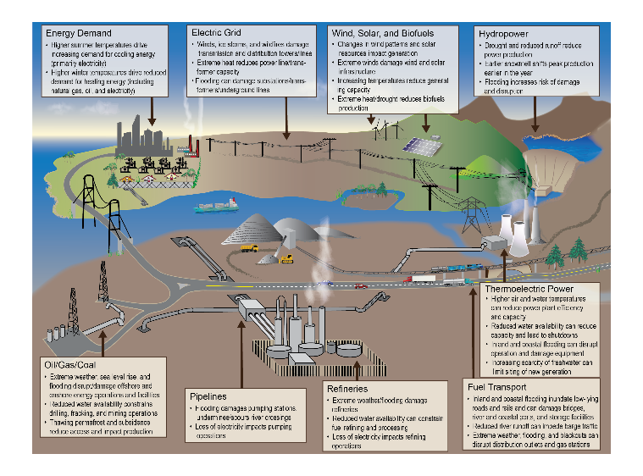
Fig. 4.1: Potential Impacts from Extreme Weather and Climate Change
Ch. 4 | Energy Supply, Delivery, and Demand
Extreme weather and climate change can potentially impact all components of the Nation’s energy system, from fuel (petroleum, coal, and natural gas) production and distribution to electricity generation, transmission, and demand. Source: adapted from DOE 2013.²³
Notes:
23: DOE, 2013: U.S. Energy Sector Vulnerabilities to Climate Change and Extreme Weather. DOE/PI-0013. U.S. Department of Energy (DOE), Washington, DC, 73 pp. http://www.energy.gov/downloads/us-energy-sector-vulnerabilities-climate-change-and-extreme-weather

Slide 6
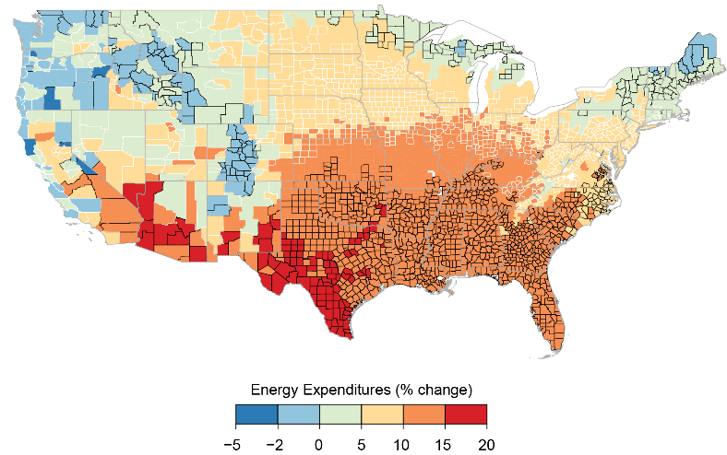
Fig. 4.2: Projected Changes in Energy Expenditures
Ch. 4 | Energy Supply, Delivery, and Demand
This figure shows county-level median projected increases in energy expenditures for average 2080–2099 impacts under the higher scenario (RCP8.5). Impacts are changes relative to no additional change in climate. Color indicates the magnitude of increases in energy expenditures in median projection; outline color indicates level of agreement across model projections (thin white outline, inner 66% of projections disagree in sign; no outline, more than 83% of projections agree in sign; black outline, more than 95% agree in sign; thick gray outline, state borders). Data were unavailable for Alaska, Hawai‘i and the U.S.-Affiliated Pacific Islands, and the U.S. Caribbean regions. Source: Hsiang et al. 2017.¹⁴
Notes:
14: Hsiang, S., R. Kopp, A. Jina, J. Rising, M. Delgado, S. Mohan, D.J. Rasmussen, R. Muir-Wood, P. Wilson, M. Oppenheimer, K. Larsen, and T. Houser, 2017: Estimating economic damage from climate change in the United States. Science,356(6345), 1362-1369. http://dx.doi.org/10.1126/science.aal4369

Slide 7
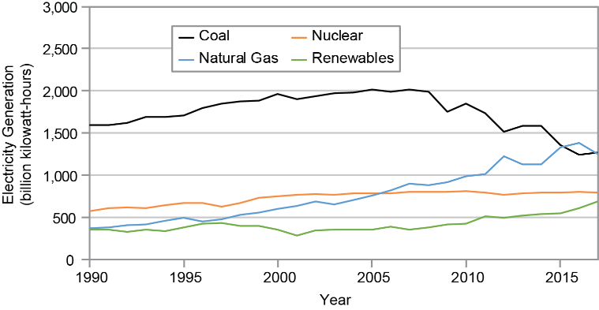
Fig. 4.3: Electricity Generation from Selected Fuels
Ch. 4 | Energy Supply, Delivery, and Demand
This figure shows electric power generation from different fuel sources and technologies. Since 2010, the declining market share from coal has been filled largely by natural gas and, to a lesser extent, renewables. Renewables include: conventional hydroelectric, geothermal, wood, wood waste, biogenic municipal waste, landfill gas, other biomass, solar, and wind power. Source: EIA/AEO 2018.⁵⁹
Notes:
59: EIA, 2018: Annual Energy Outlook 2018. AEO2018. U.S. Energy Information Administration (EIA), Washington, DC, 146 pp. https://www.eia.gov/outlooks/aeo

Slide 8
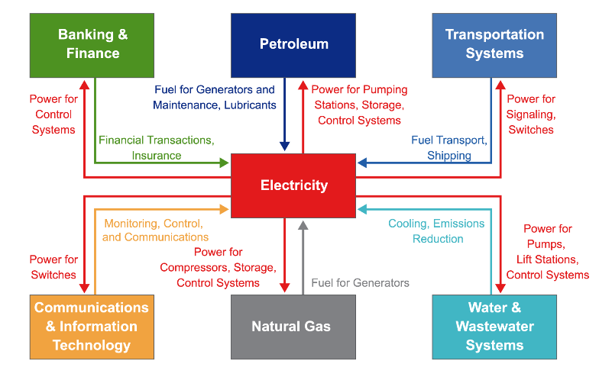
Fig. 4.4: Examples of Critical Infrastructure Interdependencies
Ch. 4 | Energy Supply, Delivery, and Demand
The interdependence of critical infrastructure systems increases the importance of electricity resilience, as disruptions to energy services are projected to affect other sectors. Shown above is a representative set of connections, and the complex relationships are analogous to other systems (Ch. 17: Complex Systems). A more complete listing of these linkages can be found at DOE.² Source: adapted from DOE 2017.²
Notes:
2: DOE, 2017: Transforming the Nation’s Electricity System: The Second Installment of the QER. DOE/EPSA-0008. U.S. Department of Energy (DOE), Washington, DC https://energy.gov/epsa/quadrennial-energy-review-second-installment

Slide 9
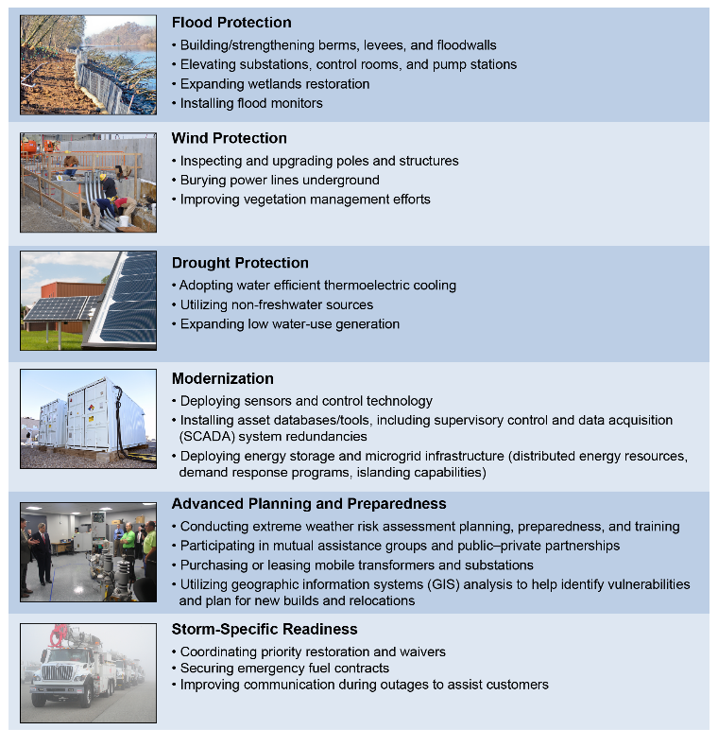
Fig. 4.5: Energy Sector Resilience Solutions
Ch. 4 | Energy Supply, Delivery, and Demand
Solutions are being deployed in the energy sector to enhance resilience to extreme weather and climate impacts across a spectrum of energy generation technologies, infrastructure, and fuel types. The figure illustrates resilience investment opportunities addressing specific extreme weather threats, as well as broader resilience actions that include grid modernization and advanced planning and preparedness. Photo credits (from top): Todd Plain, U.S. Army Corps of Engineers; Program Executive Office, Assembled Chemical Weapons Alternative; Lance Cheung, USDA; Idaho National Laboratory (CC BY 2.0); Darin Leach, USDA; Master Sgt. Roy Santana, U.S. Air Force.

Slide 10
Ch. 4 | Energy Supply, Delivery, and Demand
4
Chapter Author Team
Federal Coordinating Lead Author
Craig D. Zamuda, U.S. Department of Energy, Office of Policy
Chapter Lead
Craig D. Zamuda, U.S. Department of Energy, Office of Policy
Chapter Authors
Daniel E. Bilello, National Renewable Energy Laboratory
Guenter Conzelmann, Argonne National Laboratory
Ellen Mecray, National Oceanic and Atmospheric Administration
Ann Satsangi, U.S. Department of Energy, Office of Fossil Energy
Vincent Tidwell, Sandia National Laboratories
Brian J. Walker, U.S. Department of Energy, Office of Energy Efficiency and Renewable Energy
Review Editor
Sara C. Pryor, Cornell University

Slide 11
Ch. 4 | Energy Supply, Delivery, and Demand
4
Acknowledgments
USGCRP Coordinators
Natalie Bennett, Adaptation and Assessment Analyst
Christopher W. Avery, Senior Manager

Slide 12
Zamuda, C., D.E. Bilello, G. Conzelmann, E. Mecray, A. Satsangi, V. Tidwell, and B.J. Walker, 2018: Energy Supply, Delivery, and Demand. In Impacts, Risks, and Adaptation in the United States: Fourth National Climate Assessment, Volume II [Reidmiller, D.R., C.W. Avery, D.R. Easterling, K.E. Kunkel, K.L.M. Lewis, T.K. Maycock, and B.C. Stewart (eds.)]. U.S. Global Change Research Program, Washington, DC, USA. doi: 10.7930/NCA4.2018.CH4
https://nca2018.globalchange.gov/chapter/energy

